Slide 1
Coffee, networking and sponsor exhibition

Slide 2
Chair’s opening remarks John Mills, ALACHO and Fife Council

Slide 3
Empty no more: Homes back into use with Auction House Scotland John Loudon, Auction House Scotland

Slide 4
Empty no more: Returning homes back into use via Auction House Scotland
Proud Headline Sponsors of the 13th Scottish Empty Homes Conference
John Loudon
Auctioneer & Business Development Manager
Auction House Scotland

Slide 5
Auction House Scotland
Regional branch of Auction House UK
One of 27 regional auction teams
We sell anything anywhere in Scotland
In-room, live stream & online auctions
We’ve been working with the Scottish Empty Homes Partnership for 8 years now!

Slide 6
Auction House UK Figures for 2023
71%
£641.6m
8,418
4,844
Lots entered
Lots sold
Average sold success rate
Total
raised

Slide 7
Auction House Scotland Figures for 2023
7
252
95%
£18m
In-room/live stream auctions
Lots sold
Average sold success rate
Raised for our sellers
We also celebrated our 10th year in business last year!

Slide 8
Learning from the
past

Slide 9
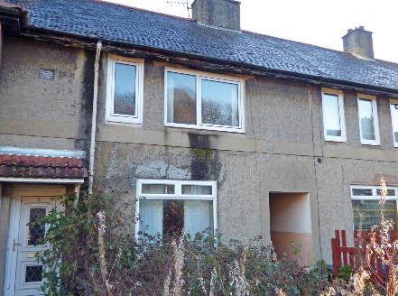
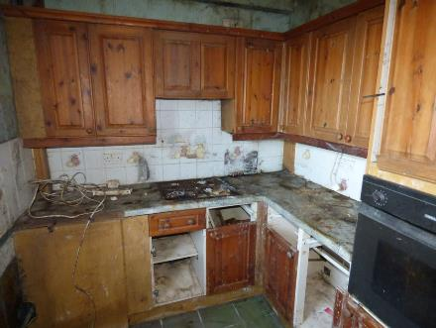
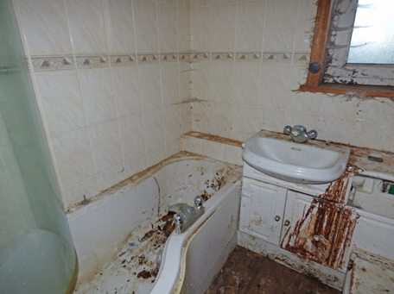
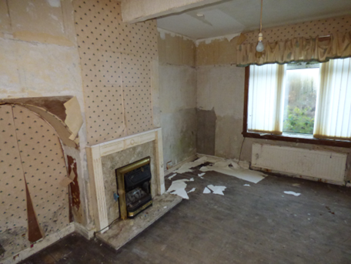
Our First Empty Homes Introduction
5 McCallum Crescent, Gourock, PA19 1PY
Home Report - £60,000
Guide - £49,000+
SOLD - £78,000

Slide 10
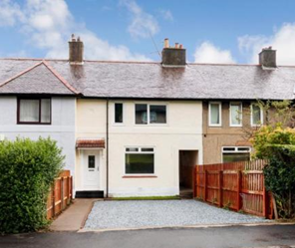
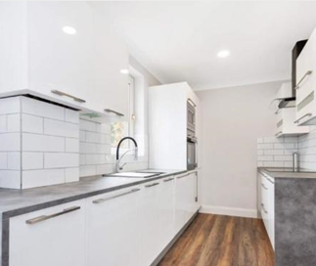
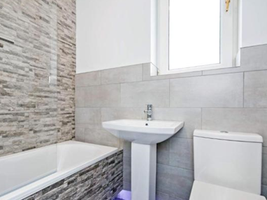
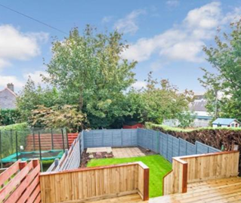
The Transformation
Renovated and SOLD for £135,000
This made a lovely family home, and the neighbours were delighted!

Slide 11
What have we learned?
Strong relationship building
Regular communication
Emotional connection
Reason why it’s empty
Supporting regional and national events over 8 years; General content to EH Officers;
Sharing success stories.
Key learning: Understanding that emotional connection sellers have with their property – whatever the reason the house has been lying empty.

Slide 12
The Unique Value of Auction
Faster and more secure than any other route
Competitive guide price drives interest
Reserve agreed to protect seller in the auction room
Unconditional sale with 10% deposit paid
Typically, 28 days completion
Sale is binding on the fall of the hammer

Slide 13
The Auction Process
Introductory call/meeting to understand your needs
Desktop valuation and Home Report
Legal Pack (including special conditions)
Hand hold with dedicated negotiator
Accompanied open viewings build competition
Maximum exposure
Reserve price protects seller in the room
Regular physical auctions in Glasgow (Radisson RED)
Sold and completed in 28 days

Slide 14
Our offer via Empty Homes
FREE auction entry
FREE For Sale board/poster
FREE PR and Social Media
FREE listing on all major portals and our website
FREE e-mail alerts to 20,000+ auction buyers
FREE accompanied viewings
FREE of any initial listing costs
FOR SALE

Slide 15
Empty Homes Success Stories
So far, we've sold 65 homes that were introduced to us by the Scottish Empty Homes Partnership!

Slide 16
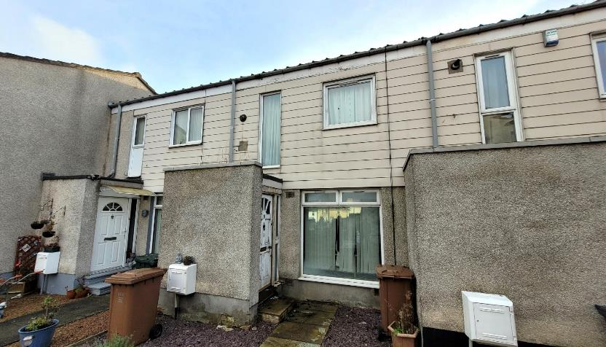
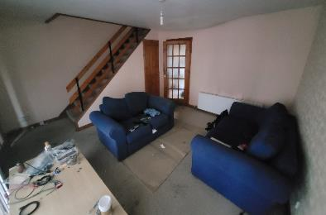
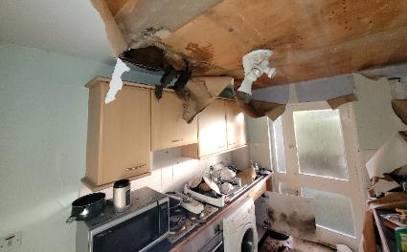
691 Ferry Road, Edinburgh
2 bedroom house
Our most recent Empty Homes sale (in-room auction, Tuesday 6th February at The Radisson RED Hotel in Glasgow)
Guide price: £75,000+
Sold for: £131,000

Slide 17
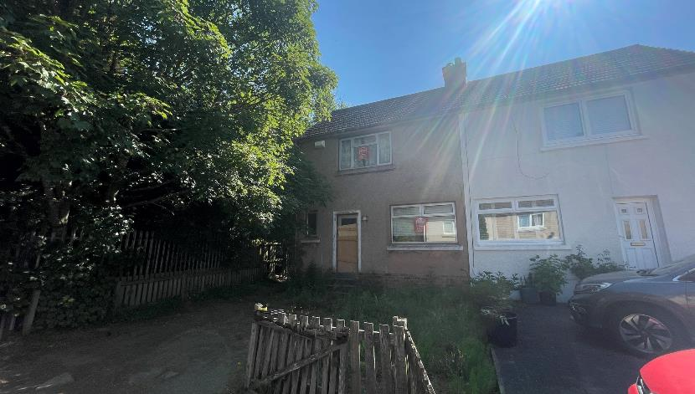
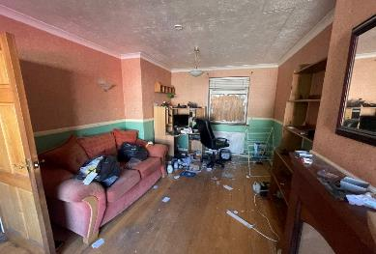
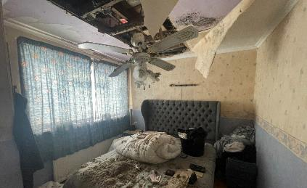
48 Greenfield Crescent, Wishaw
2 bedroom house
A 2023 highlight
(in-room auction, Thursday 20th July at The Radisson RED Hotel in Glasgow)
Guide price: £30,000+
Sold for: £57,000

Slide 18
Visions for the
future

Slide 19
Empty No More
We’re setting up in-house livestreams to respond even faster to sellers looking for competitive auction bidding, allowing this to be available at even shorter notice.
Speed is invaluable for sellers with properties that have been empty for a long time and they need to sell fast.
We look forward to continuing our support of the SEHP locally and nationally.

Slide 20
Upcoming auctions
Thursday 21st March (In-room and livestream)
The Radisson RED Hotel, Glasgow
Thursday 9th May (In-room and livestream)
The Radisson RED Hotel, Glasgow
We also have weekly National Online Auctions every Tuesday!

Slide 21
Get in touch
john@auctionhousescotland.com
0141 339 4466 | 07903 678 441
Connect with me
on LinkedIn:
Email us at:
info@auctionhousescotland.com
Office 2, Craigs Business Centre, Macdowall Street, Paisley PA3 2NB

Slide 22
Panel discussion: How can and should empty homes help address housing need? Alison Watson, Shelter Scotland Cllr Robin Currie, Argyll & Bute Council Joe Brown, Scottish Government

Slide 23
Learning from the past: The independent audit of empty homes work in Scotland Anna Evans, Indigo House

Slide 24
Scottish Empty Homes Conference
Learning from the Past:
the independent audit of privately owned empty homes in Scotland
Anna Evans, Indigo House
February 2024

Slide 25
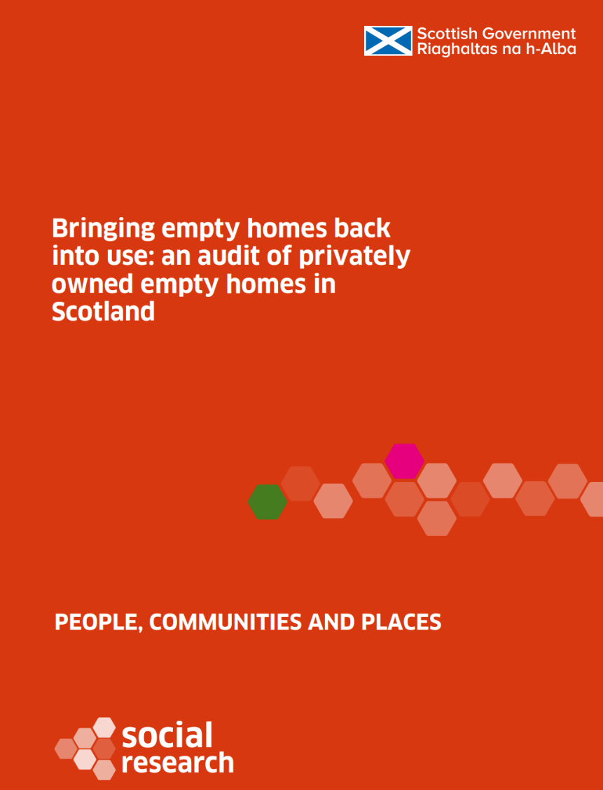
Independent audit of private empty homes in Scotland
25
Research questions
What is the current picture of privately owned empty homes - scale, characteristics and impact of empty homes?
What are the key barriers to, and opportunities for, bringing empty homes back into use?
How successful have existing approaches and interventions been in bringing empty homes back into use?
How could these approaches and interventions be improved and what further actions could be taken?
Note re CPOs and CSOs outwith scope.
Research team – Anna Evans, Mandy Littlewood, Regina Serpa, Eddy Graham and Andrea Paterson

Slide 26
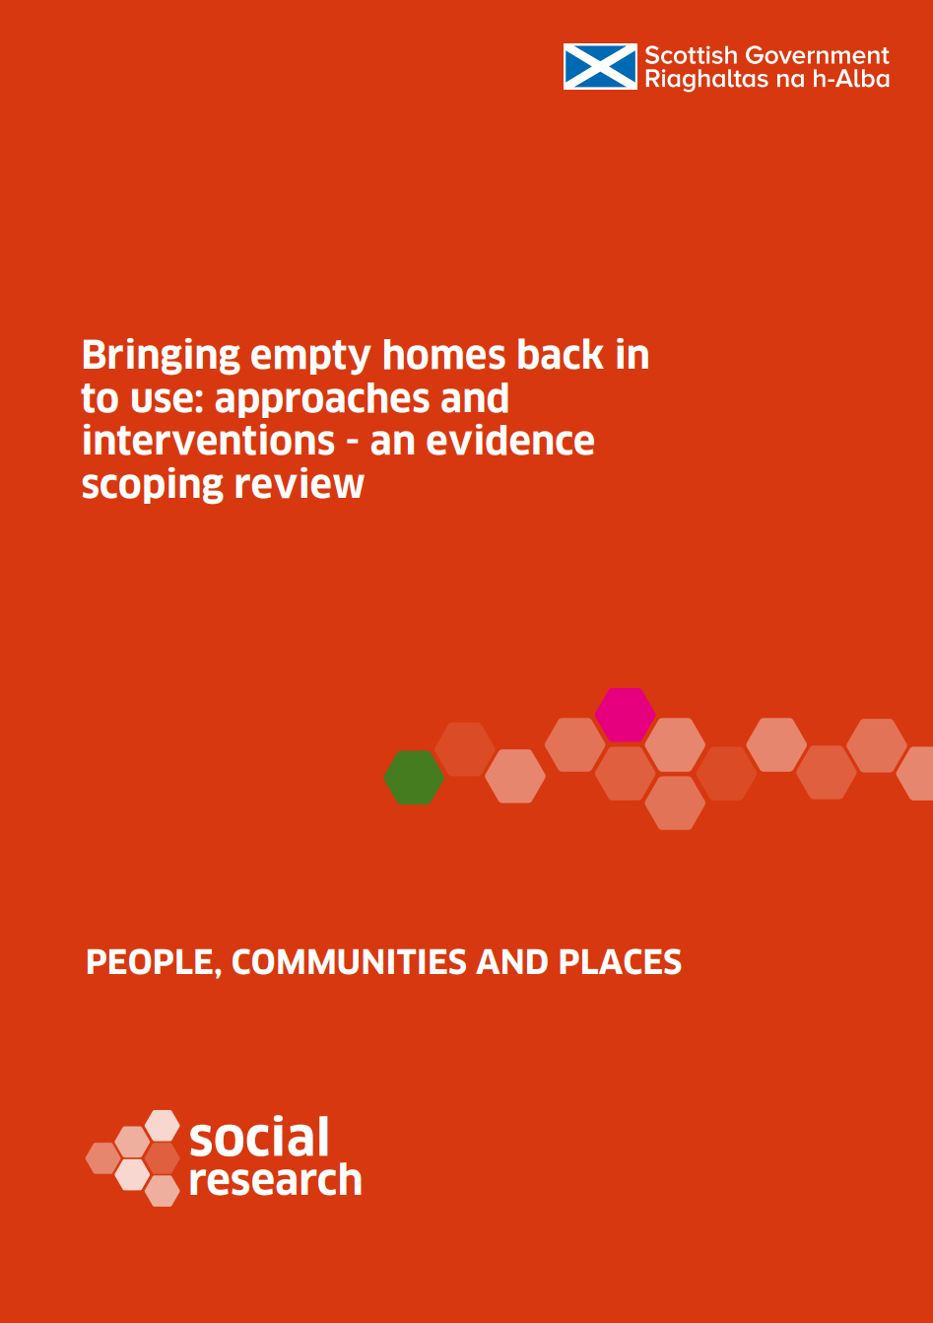
Independent audit of private empty homes in Scotland
26
How the study was undertaken
Evidence review – building on the Scottish Government’s own evidence scoping review
Policy review and analysis of the existing approaches
Value of money assessment of current approaches and interventions
Quantitative surveys
local authorities – 29 out of 32
empty homes owners - 197 from 18 different areas.
Qualitative research – interviews with local authorities, wider stakeholders, and empty homeowners.
Housing and Regeneration Research Communities Analysis Division
Notes:
VFM framework – 5/13 interventions assessed due to availability of data – considered cost, outcomes, funding sources.

Slide 27
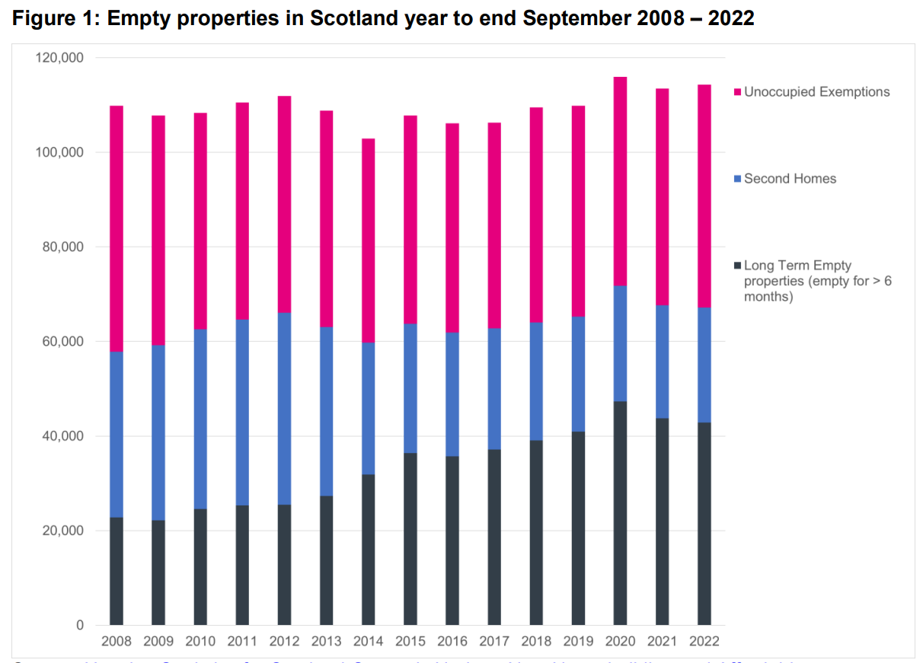
Independent audit of private empty homes in Scotland
The position of empty homes in Scotland
Data challenges
Total estimated – 114,308
Long-term empty homes (6mths) – 1.6%
Categorisation and interchangeability
Impact of LA discretion of council tax 2013
Change last 10 years
All | 2%
Long term | 68%
Second homes | -40%
Unoccupied exemptions | 3%
Notes:
Self reporting
Long term empties increased – reclassification
Lack of currency, basic, lack of integration with CTR, bespoke approaches.
Access to information - Sometimes dependent on relationships between different departments.
Difference between the estimates, and databases used for actual work on empty homes
Not using CTR as the base for casework – may start, then get info from public, councillors, other departments
Inaccuracy
Some unoccupied exemptions may also be very long empty homes –if they were recatorgised that would be helpful for identification and action
SEHP support role on data analysis
Type Estimate Change last 10 years
September 2022
All 114,308 2% increase
Long term 43,766 68%
Second homes 24,287 -40%
Unoccupied exemptions 47,156 3%

Slide 28
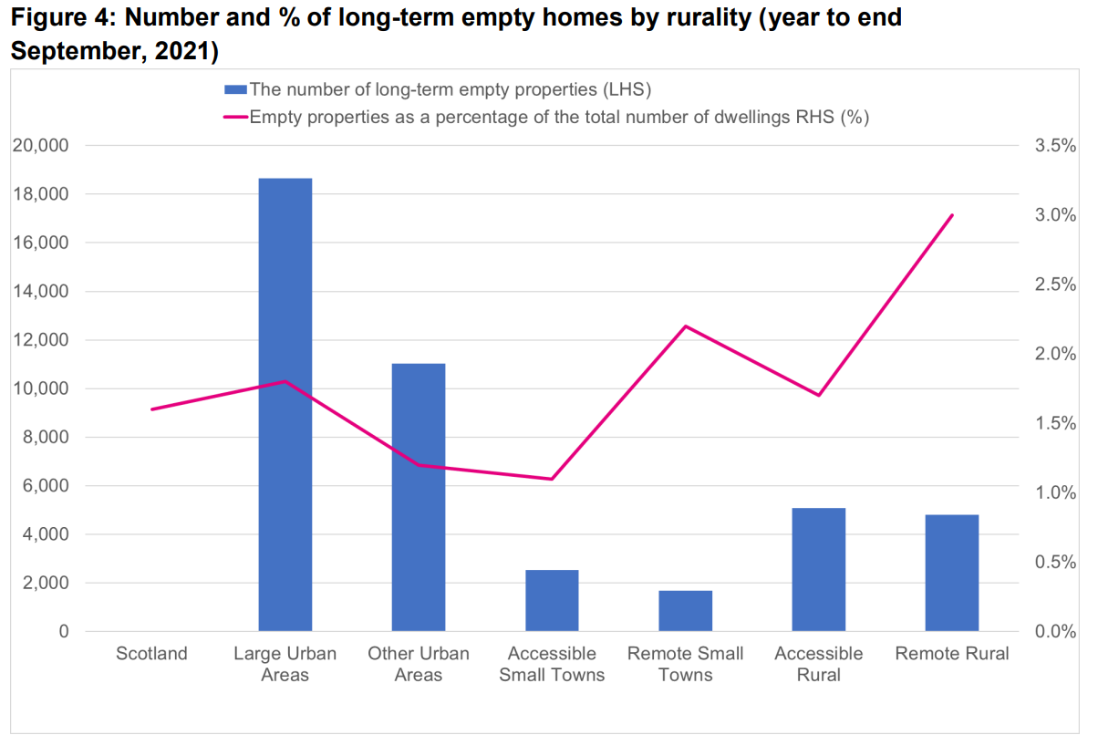
Independent audit of private empty homes in Scotland
The position on long-term empty homes in Scotland
Long term 6 months
Average 1.6% of stock
Most in the larger urban areas
Proportionally more in rural areas
Not uniform picture by LA
But
Long term empties for 12 mths
More useful for intervention
Even larger range suggesting
data issues/different approaches
LA Survey showed lack of data
on size and type of property, high or
low demand
Notes:
The latest figure for England of 248,633 is 1% of all dwellings (compared to Scotland’s 1.6%), with a 5% increase on the 2021 figure (Figure 6)
(only 5 out of 29) were able to provide an assessment of the type of empty properties. In three of the five cases the majority of empty properties were houses, while in two out of the five cases these were flats. No-one was able to provide an assessment of the size of the empty homes reported.

Slide 29
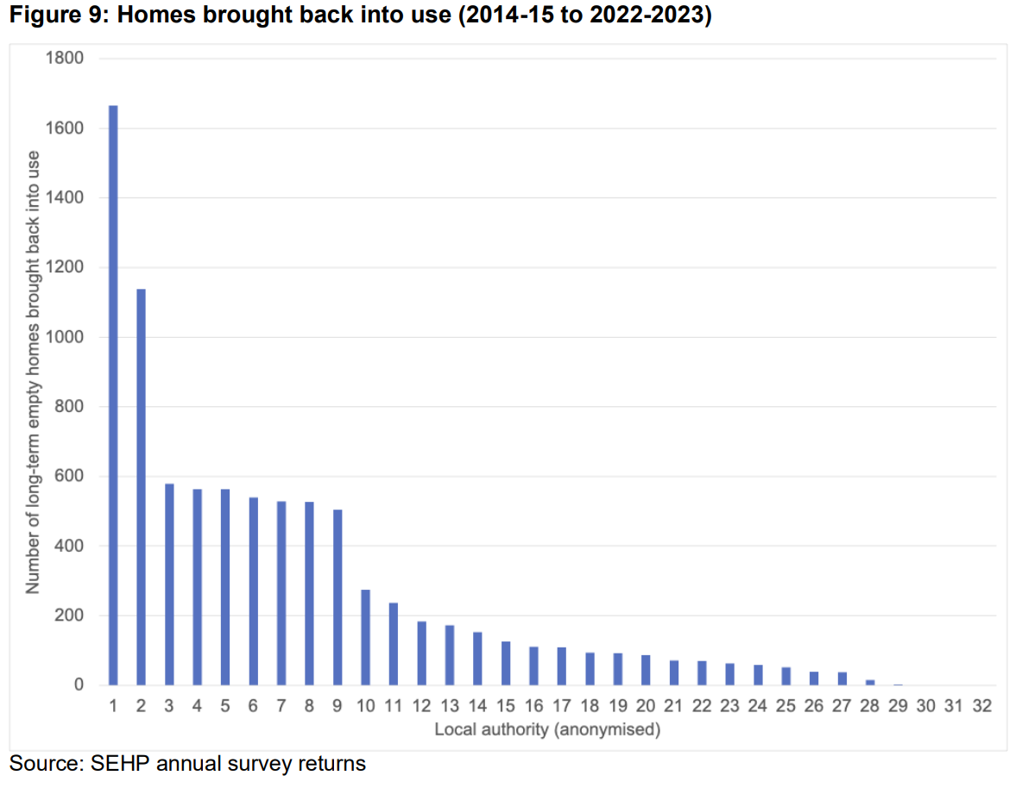
Independent audit of private empty homes in Scotland
Progress in bringing homes back into use
Last 2 years – around 1,100-1,200 pa where EHO involved
Most properties back into use where there is larger stock
But a few smaller areas 400+ back
Significant reductions where:
Matchmaker schemes
EHOs in place
Demolition schemes
External housing market drivers – population, price change, tourism economies, affect where there are more empty homes

Slide 30
Independent audit of private empty homes in Scotland
Barriers to bringing homes back into use
Local authorities
Determining ownership, lack of engagement and owners deceased/ probate
Owners’ financial barriers
Local authorities limited EHO resources
Choice
Home owners’ opinion
Practical reasons – refurbishment including lack of contractors
Financial barriers
Housing market makes unviable to bring back into use / sell
Personal reasons / family / attachment
Regulation in PRS
“Whilst there are people allowed to have empty homes, there's nothing to stop them doing that if they're paying the premium on it or whatever they're due, they're looking after it and it's not causing an issue. There's very little we could really do about that.” (City local authority).
“Farm is inherited but not inhabitable due to damp, collapsed flooring and other issues. In process of getting plans to apply for new build to replace but can’t afford to fix property at present.”
“It was my parents’ house. Sentimental value.”
Notes:
Includes Associated administrative issues / data protection

Slide 31
Independent audit of private empty homes in Scotland
Current approaches
Empty Homes Officer role is critical
More EHOs = more empty homes back into use
Zero EHOs = zero empty homes back into use
More restricted resources are reactive not strategic
Information and advice, and proactive dialogue
Using council tax discretion to lever action
Homeowner satisfaction is greater when EHO involved, but variability in awareness about EHOs
Scottish Empty Homes Partnership – key enabler; the increase in EHOs would not have happened without SHEP and funding.
Wider financial approaches - variable uptake
Enforcement – CPOs expensive with call for CSOs
Notes:
2022/23
1 FTE = 79 properties;
Less than 1 FTE = 9 properties

Slide 32
Independent audit of private empty homes in Scotland
Value for money
Empty Homes Officers | £1,075 per home
SEHP | £3,542 per home
Empty Homes Loan Fund | £11,126 per home
Town Centre Empty Homes Fund – grant and loan | £27,110 per home
Rural and Islands Housing Grant | £82,117 per home
EHOs and SEHP – low cost, delivering the most homes Loans – best value of funding mechanisms in the long term – recycle the funding Grant – also relevant, better value for affordable housing in perpetuity Balanced package of measures needed to match local circumstances
Notes:
2022/23
1 FTE = 79 properties;
Less than 1 FTE = 9 properties

Slide 33
Independent audit of private empty homes in Scotland
Recommendations
Long term empty homes – define as 12 months+
Council tax systems - clear definition for reporting of long-term empty homes
Council tax premiums – maximise flexibility to facilitate homes coming back into use – they should not create financial hardship/barriers to bringing homes into use
Council tax premiums should only be applied from start of ownership
SEHP support LAs on awareness campaign on EHOs
Local Housing Strategy guidance to emphasise the role of EHOs
Scottish Government, LAs and SEHP – targeting resources for EHOs
CPO legislation review – including enforced sales and rental orders
Scottish empty homes loan scheme – centralised administration
Review energy efficiency schemes to ensure funding for empty homes

Slide 34
Morning tea break / sponsor exhibition

Slide 35
Sofa session: Learnings from empty homes projects Susan Aktemel and Barry Sweeney, Homes for Good Douglas Whyte and Isla Binnie, Argyll & Bute Council Donna Smith, Tighean Innse Gall Harry Whitmore, SOSCH

Slide 36
Scottish Empty Homes Conference 2024 Susan Aktemel; Founder and CEO Barry Sweeney; Head of Acquisitions and Assets

Slide 37
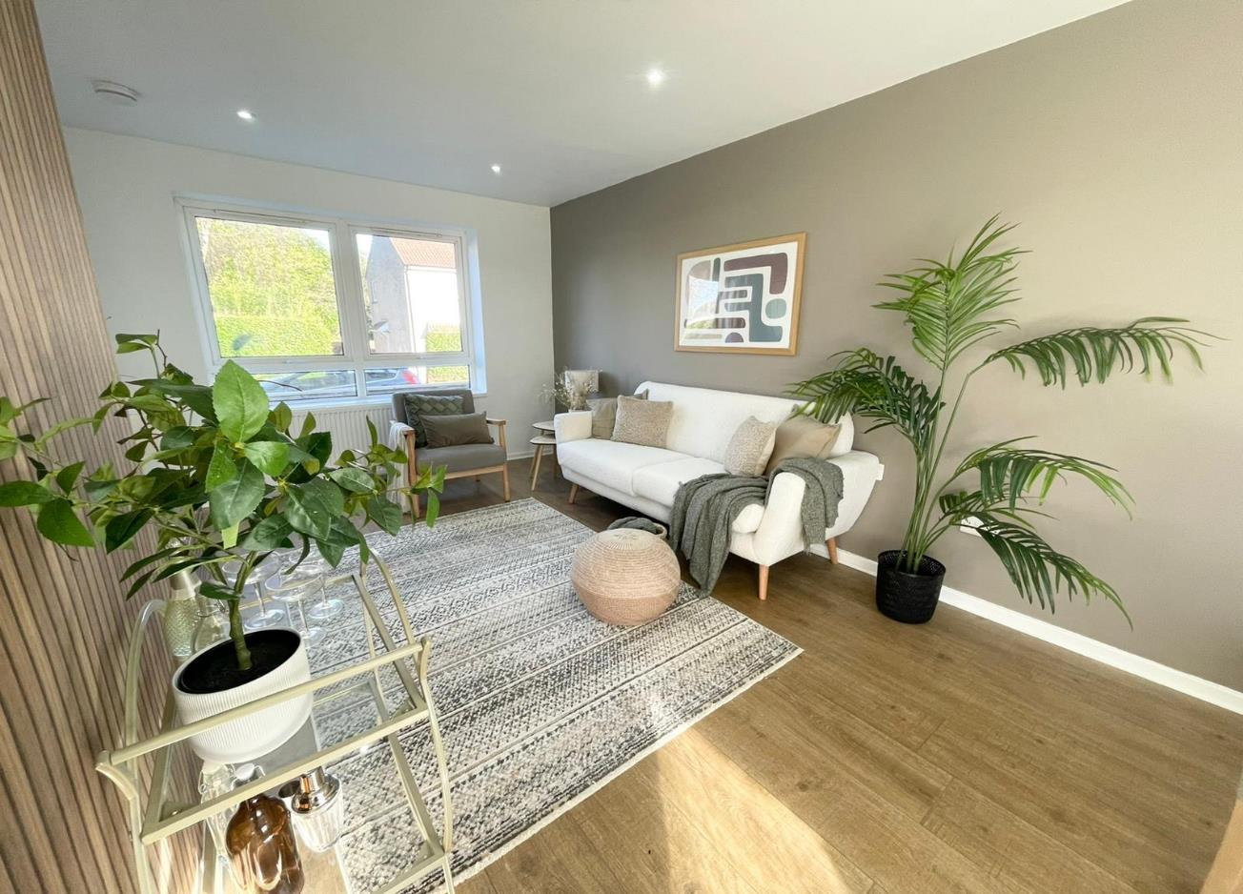

Slide 38
Project Aims
Bring private sector long term empty homes back into use across the West of Scotland, focusing on Glasgow, Ayrshire and Renfrewshire
Increase the supply of secure, quality homes for people on low incomes or benefits within the private rented sector
Share best practice and innovation within the sector to encourage other organisations to participate in empty homes work
Notes:
Susan

Slide 39
What we have achieved so far
Established HFG as a contributor to SEHP Network
Built relationships with Local Authority Empty Homes Officers
Market and Refurb guidance & support to over 20 EH owners allowing them to progress
Supported at least 4 EH owners to sell property through agent/ auction
2 owner properties being renovated through our Rent Ready pilot scheme
18 EH’s purchased by HFG and transformed into affordable homes
Notes:
Susan

Slide 40
What we have learned
Notes:
BARRY

Slide 41
Successes
Open, honest and straightforward approach works best
Complexities around EH’s
Capacity to provide solutions has increased
Being able to move quickly works
Challenges
Timeframes – Patience required at all times
Understanding complex reasons for Empty Homes
Managing owners expectations
Costs of refurb are major barrier to progress
Notes:
BARRY

Slide 42
HFG Empty Home Projects
Notes:
SUSAN

Slide 43
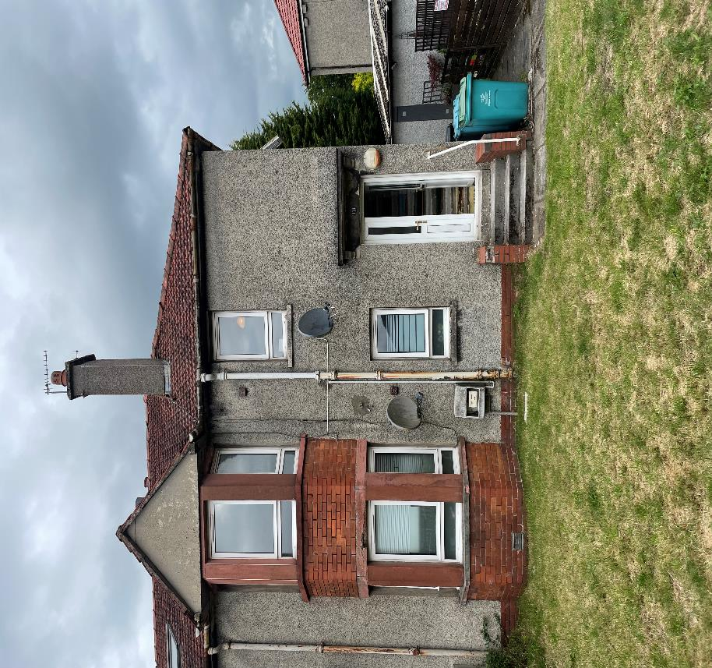
Manse Road, Kilsyth
1 Bedroom Flat
Empty for around 3 Years
Major problem for downstairs neighbor
Severe Rot issues
Previous Anti Social Behaviour
Notes:
Examples of our work around Empty Homes;

Slide 44
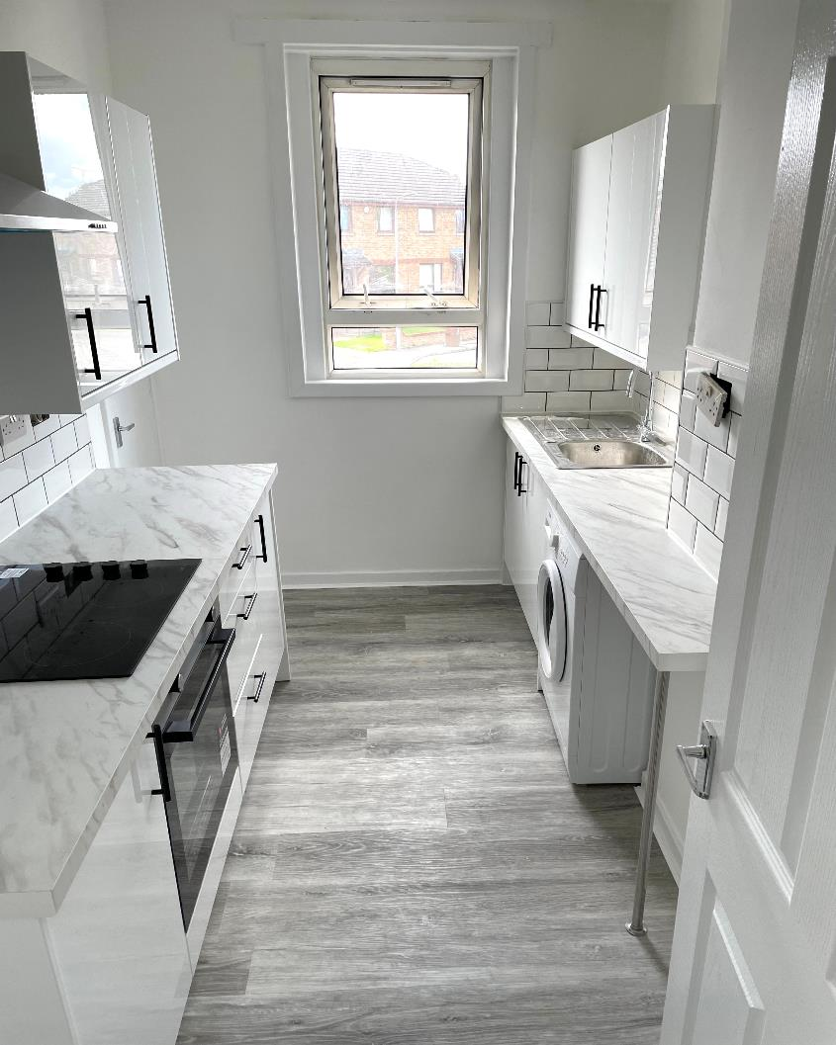
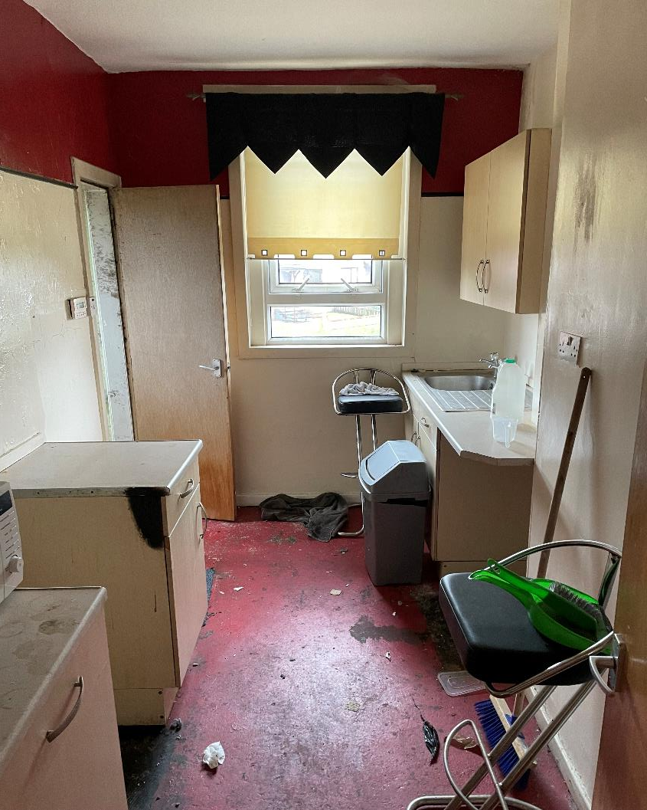
Notes:
“What does it mean to me?” - to pitch this section to the team.
Opportunities skill share with team in London. Challenge of replicating our model - we’ll learn a lot and they will learn from us.

Slide 45
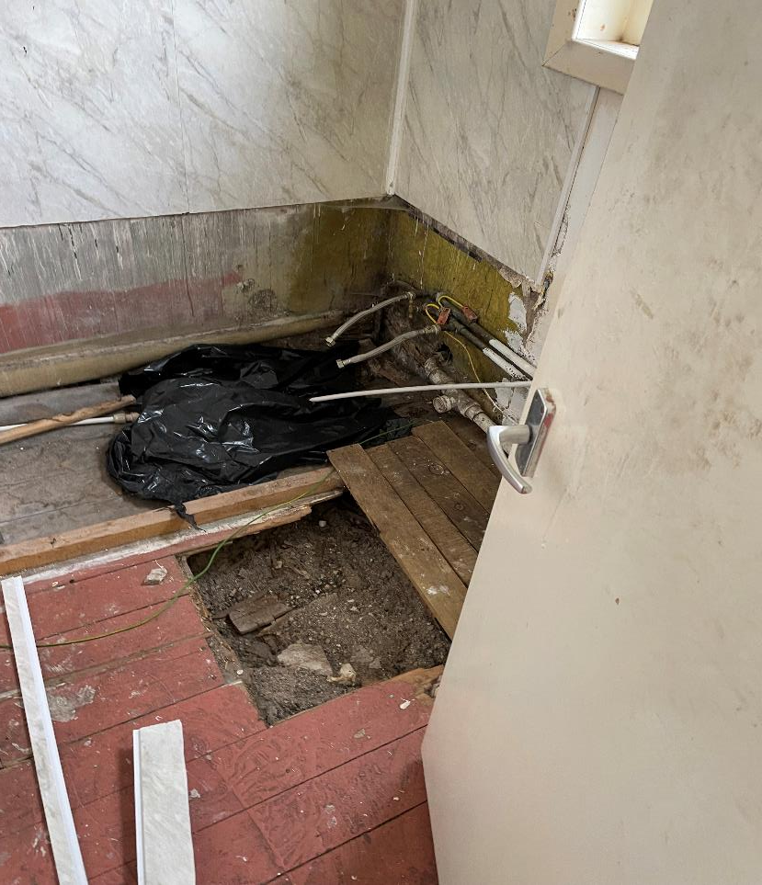
Notes:
“What does it mean to me?” - to pitch this section to the team.
Opportunities skill share with team in London. Challenge of replicating our model - we’ll learn a lot and they will learn from us.

Slide 46
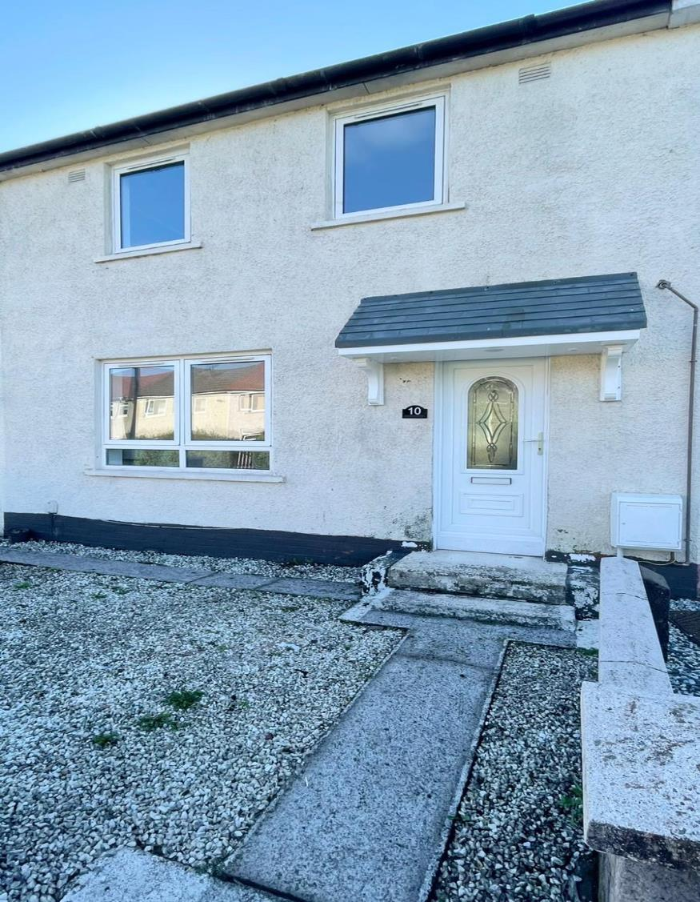
Craigmount Ave, Paisley
Mid Terr 2 Bedroom House
Empty for around 2 Years
Full Refurb required
Major improvements including a new Heating System & Insulation
Great Family Home!
Notes:
Examples of our work around Empty Homes;

Slide 47
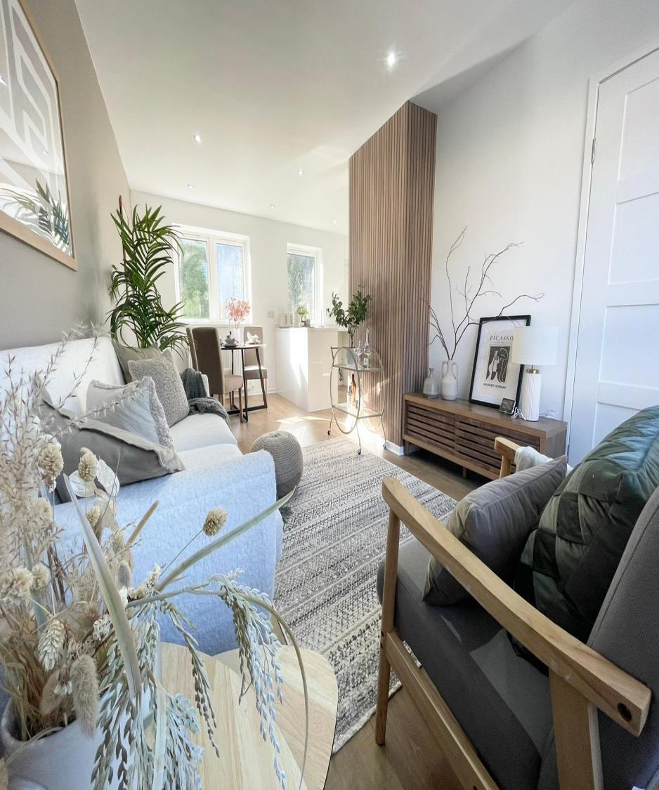
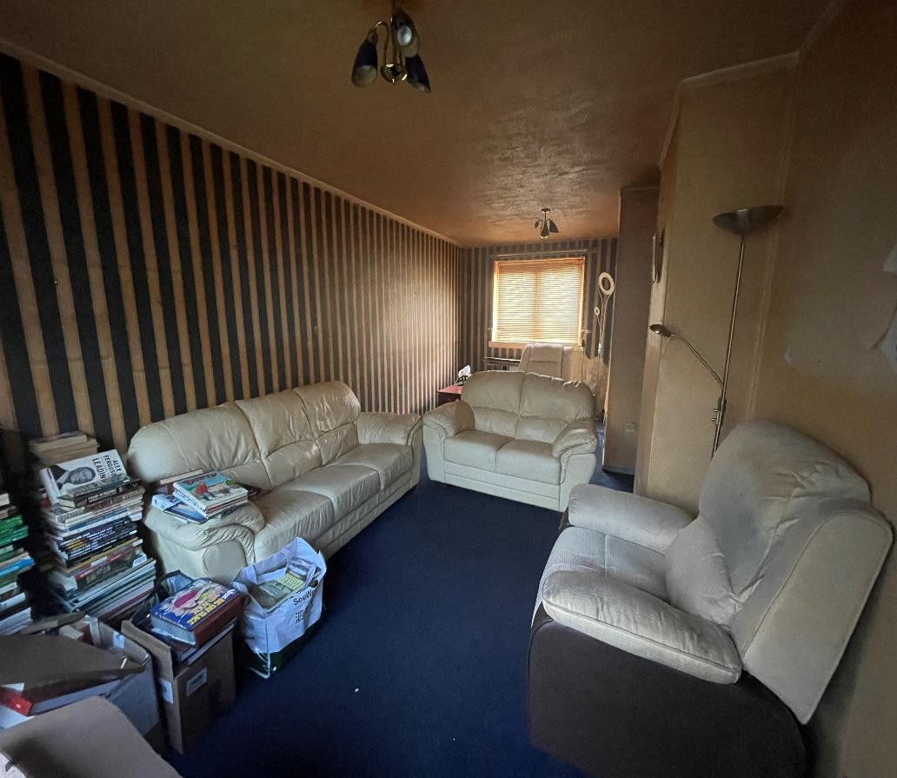
Notes:
“What does it mean to me?” - to pitch this section to the team.
Opportunities skill share with team in London. Challenge of replicating our model - we’ll learn a lot and they will learn from us.

Slide 48
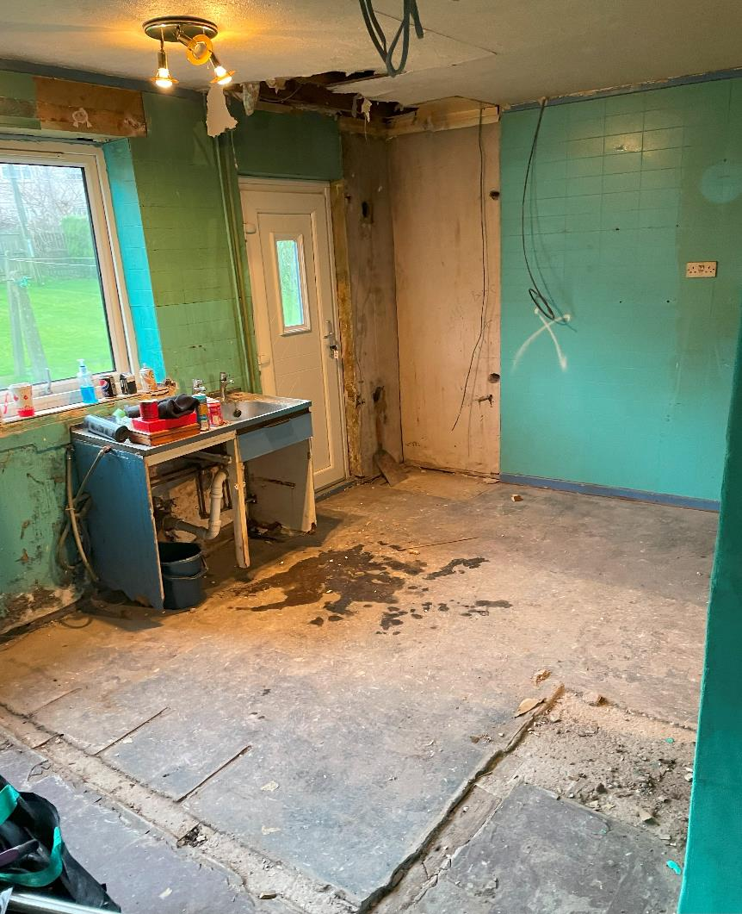
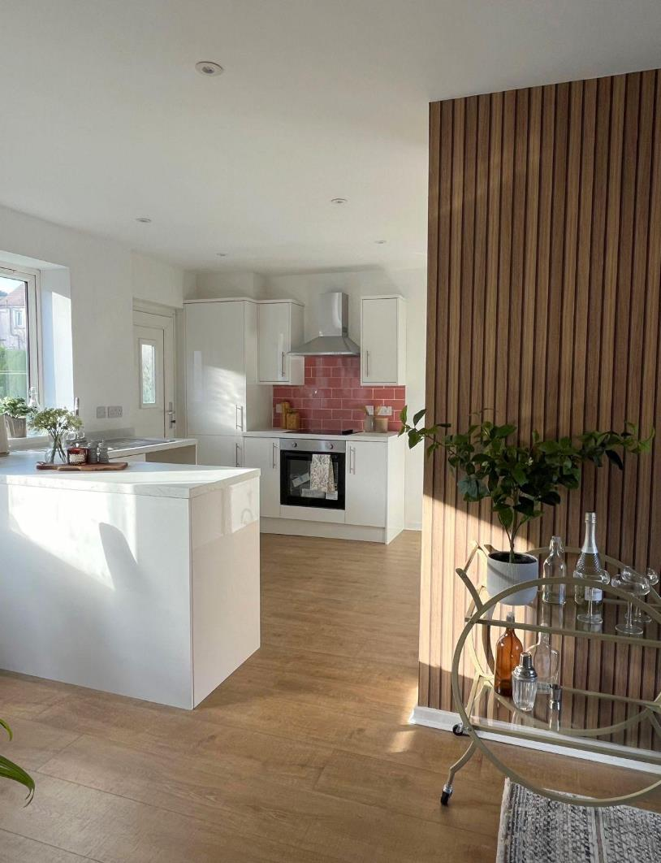
Notes:
“What does it mean to me?” - to pitch this section to the team.
Opportunities skill share with team in London. Challenge of replicating our model - we’ll learn a lot and they will learn from us.

Slide 49
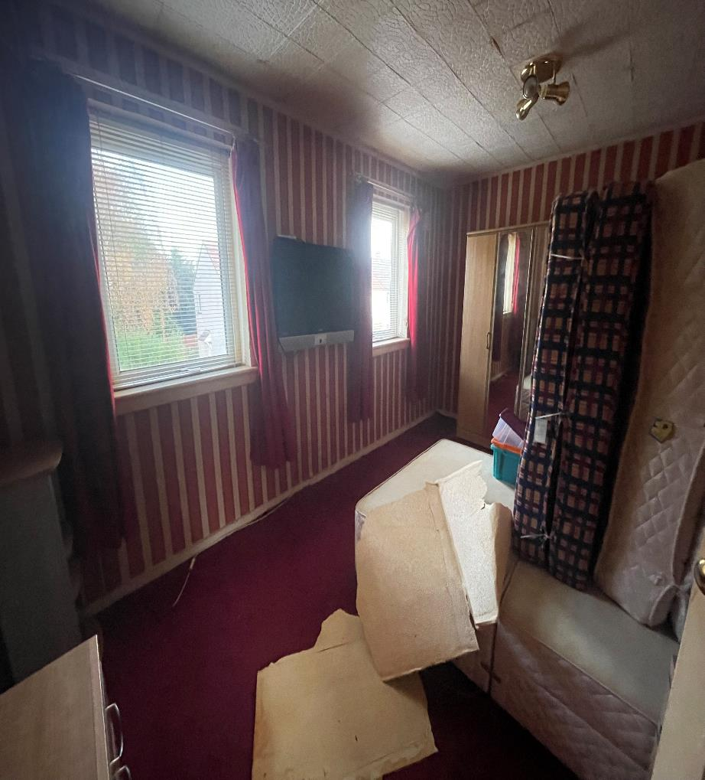
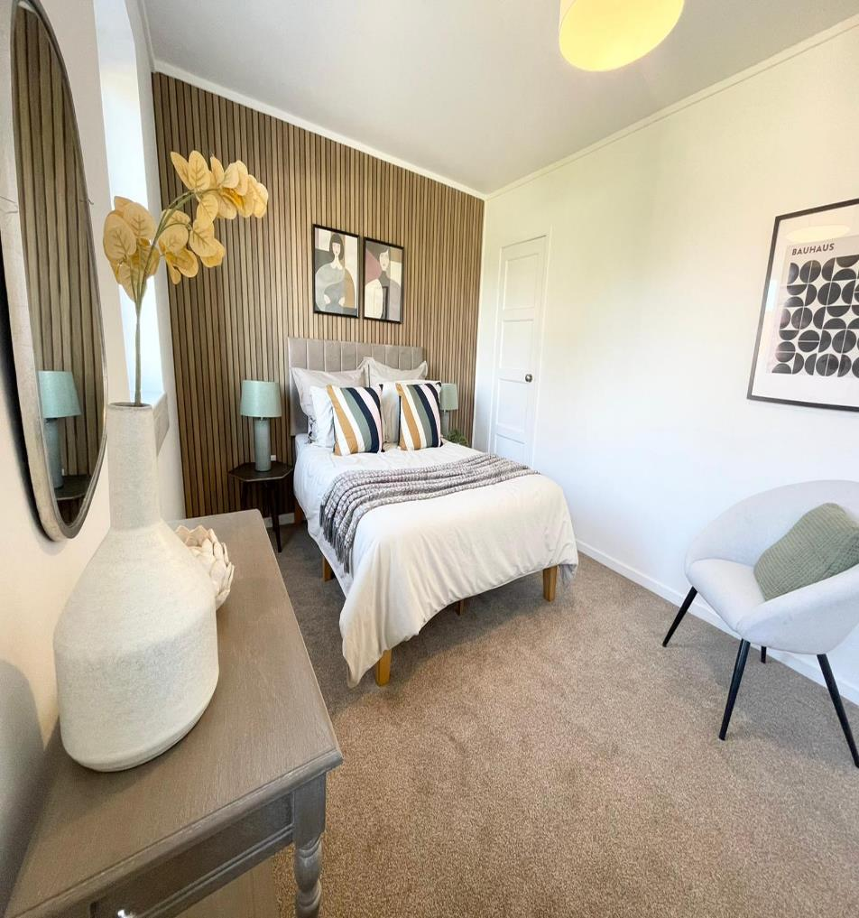
Notes:
“What does it mean to me?” - to pitch this section to the team.
Opportunities skill share with team in London. Challenge of replicating our model - we’ll learn a lot and they will learn from us.

Slide 50
Rent Ready Pilot
Notes:
BARRY

Slide 51
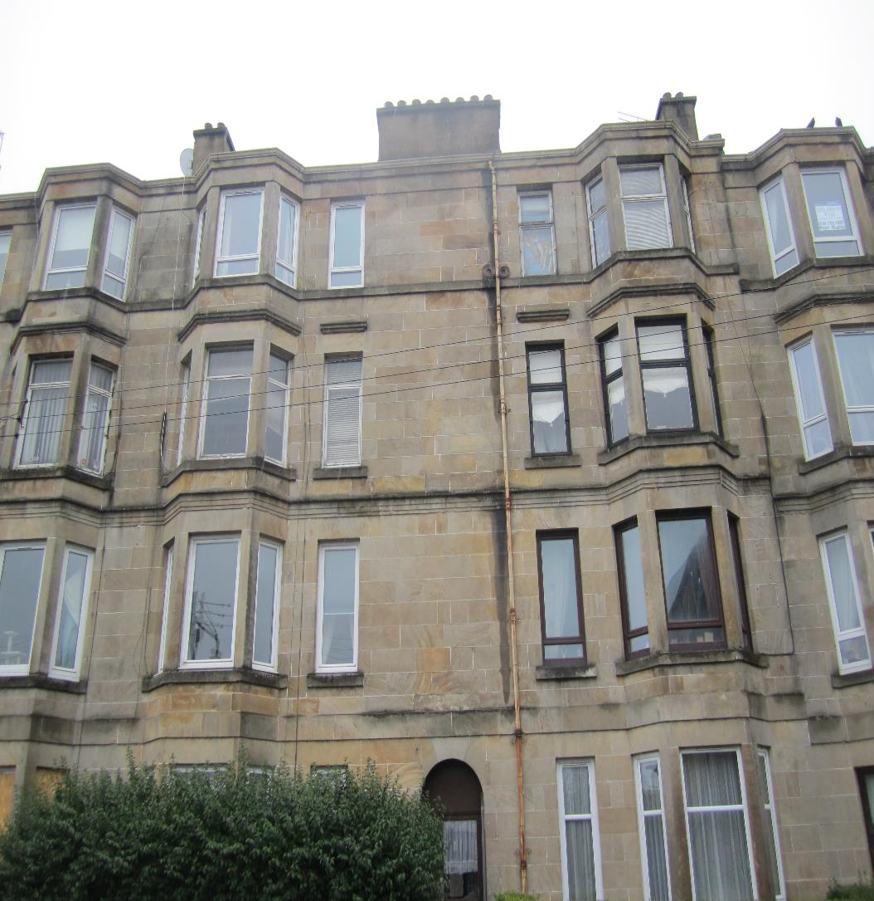
18 Trainard Ave
Empty for around 6 Years
Share expertise with owners
2 Bedroom Conversion
Rent Ready pilot
Notes:
Examples of our work around Empty Homes;

Slide 52
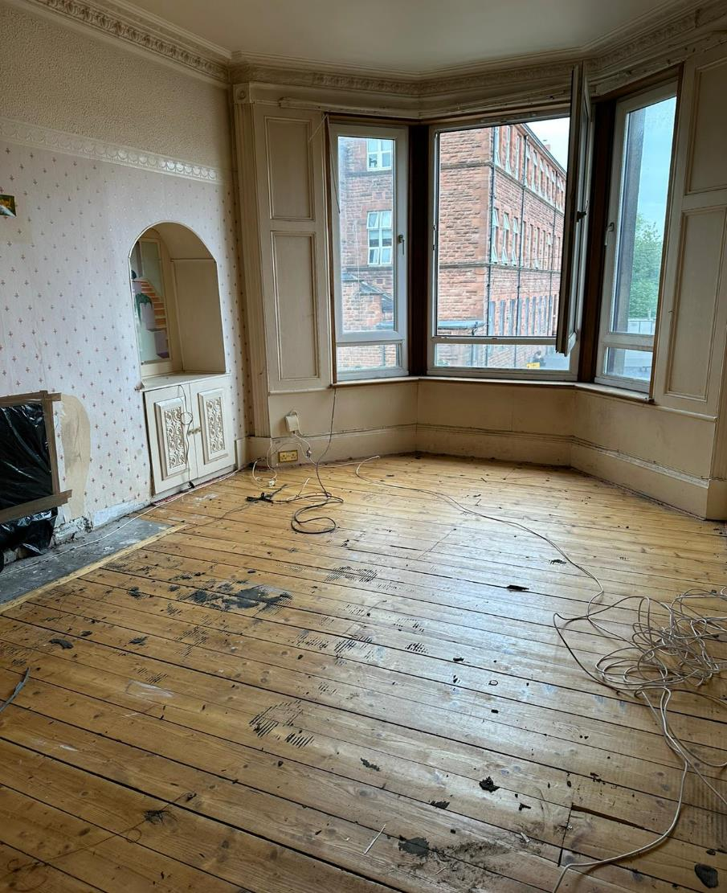
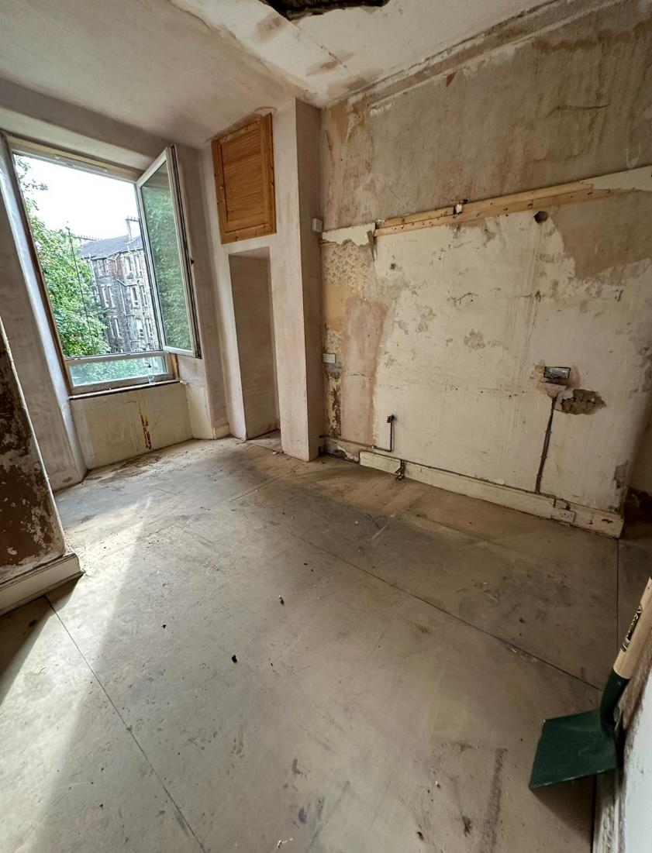
Notes:
“What does it mean to me?” - to pitch this section to the team.
Opportunities skill share with team in London. Challenge of replicating our model - we’ll learn a lot and they will learn from us.

Slide 53
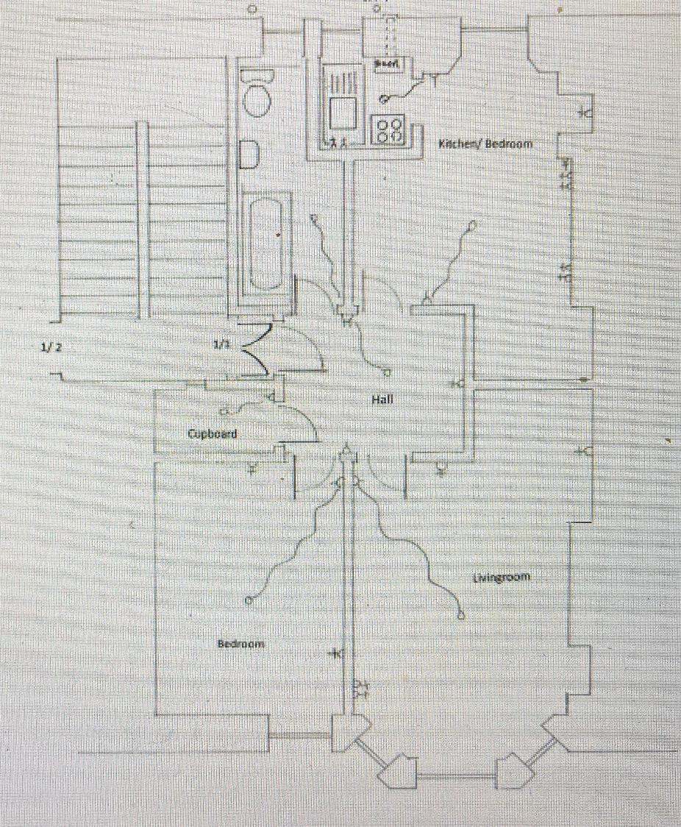
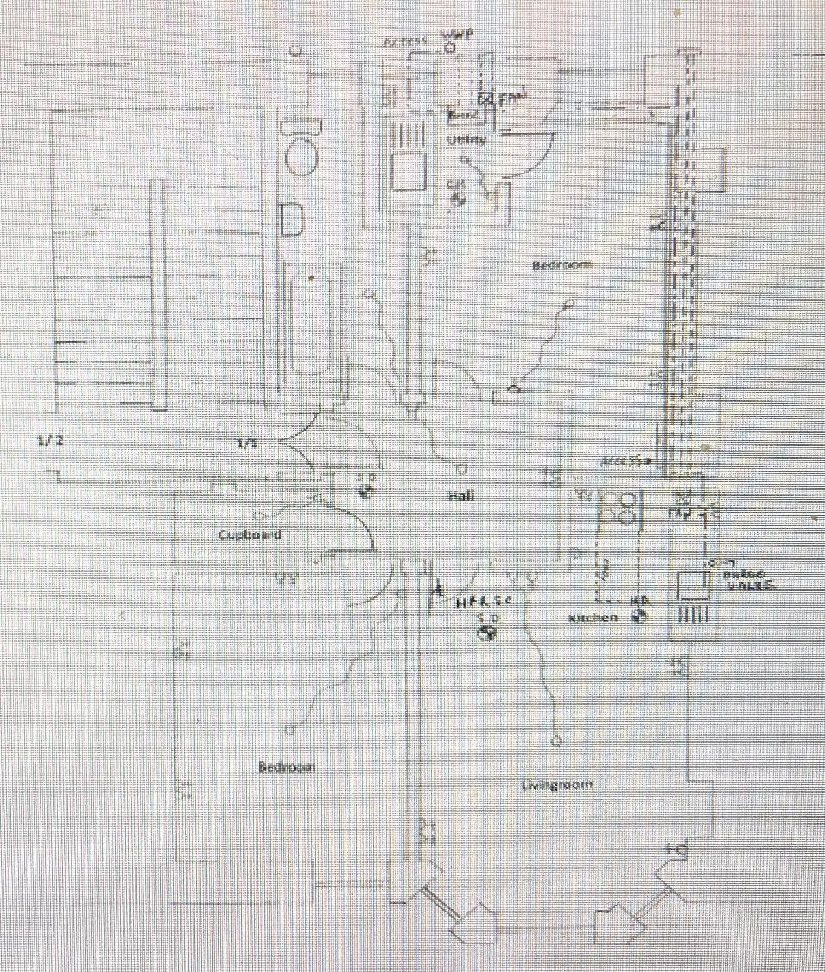
Notes:
“What does it mean to me?” - to pitch this section to the team.
Opportunities skill share with team in London. Challenge of replicating our model - we’ll learn a lot and they will learn from us.

Slide 54
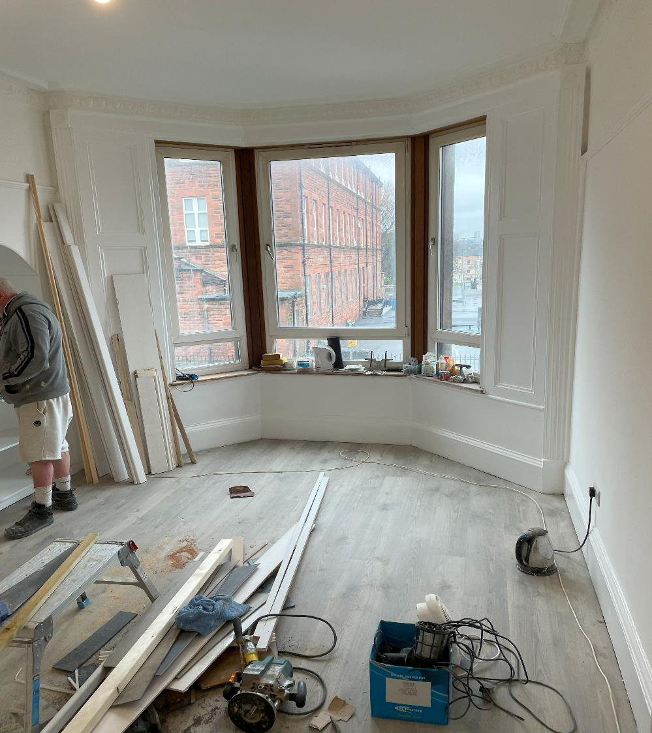
18 Trainard Ave
Work closely with owners
Produce plans
Apply for Building Warrant
Create Design Plan
Gather quotes
Manage Refurb
Notes:
Examples of our work around Empty Homes;

Slide 55
Dyke St - Film
Notes:
SUSAN

Slide 56
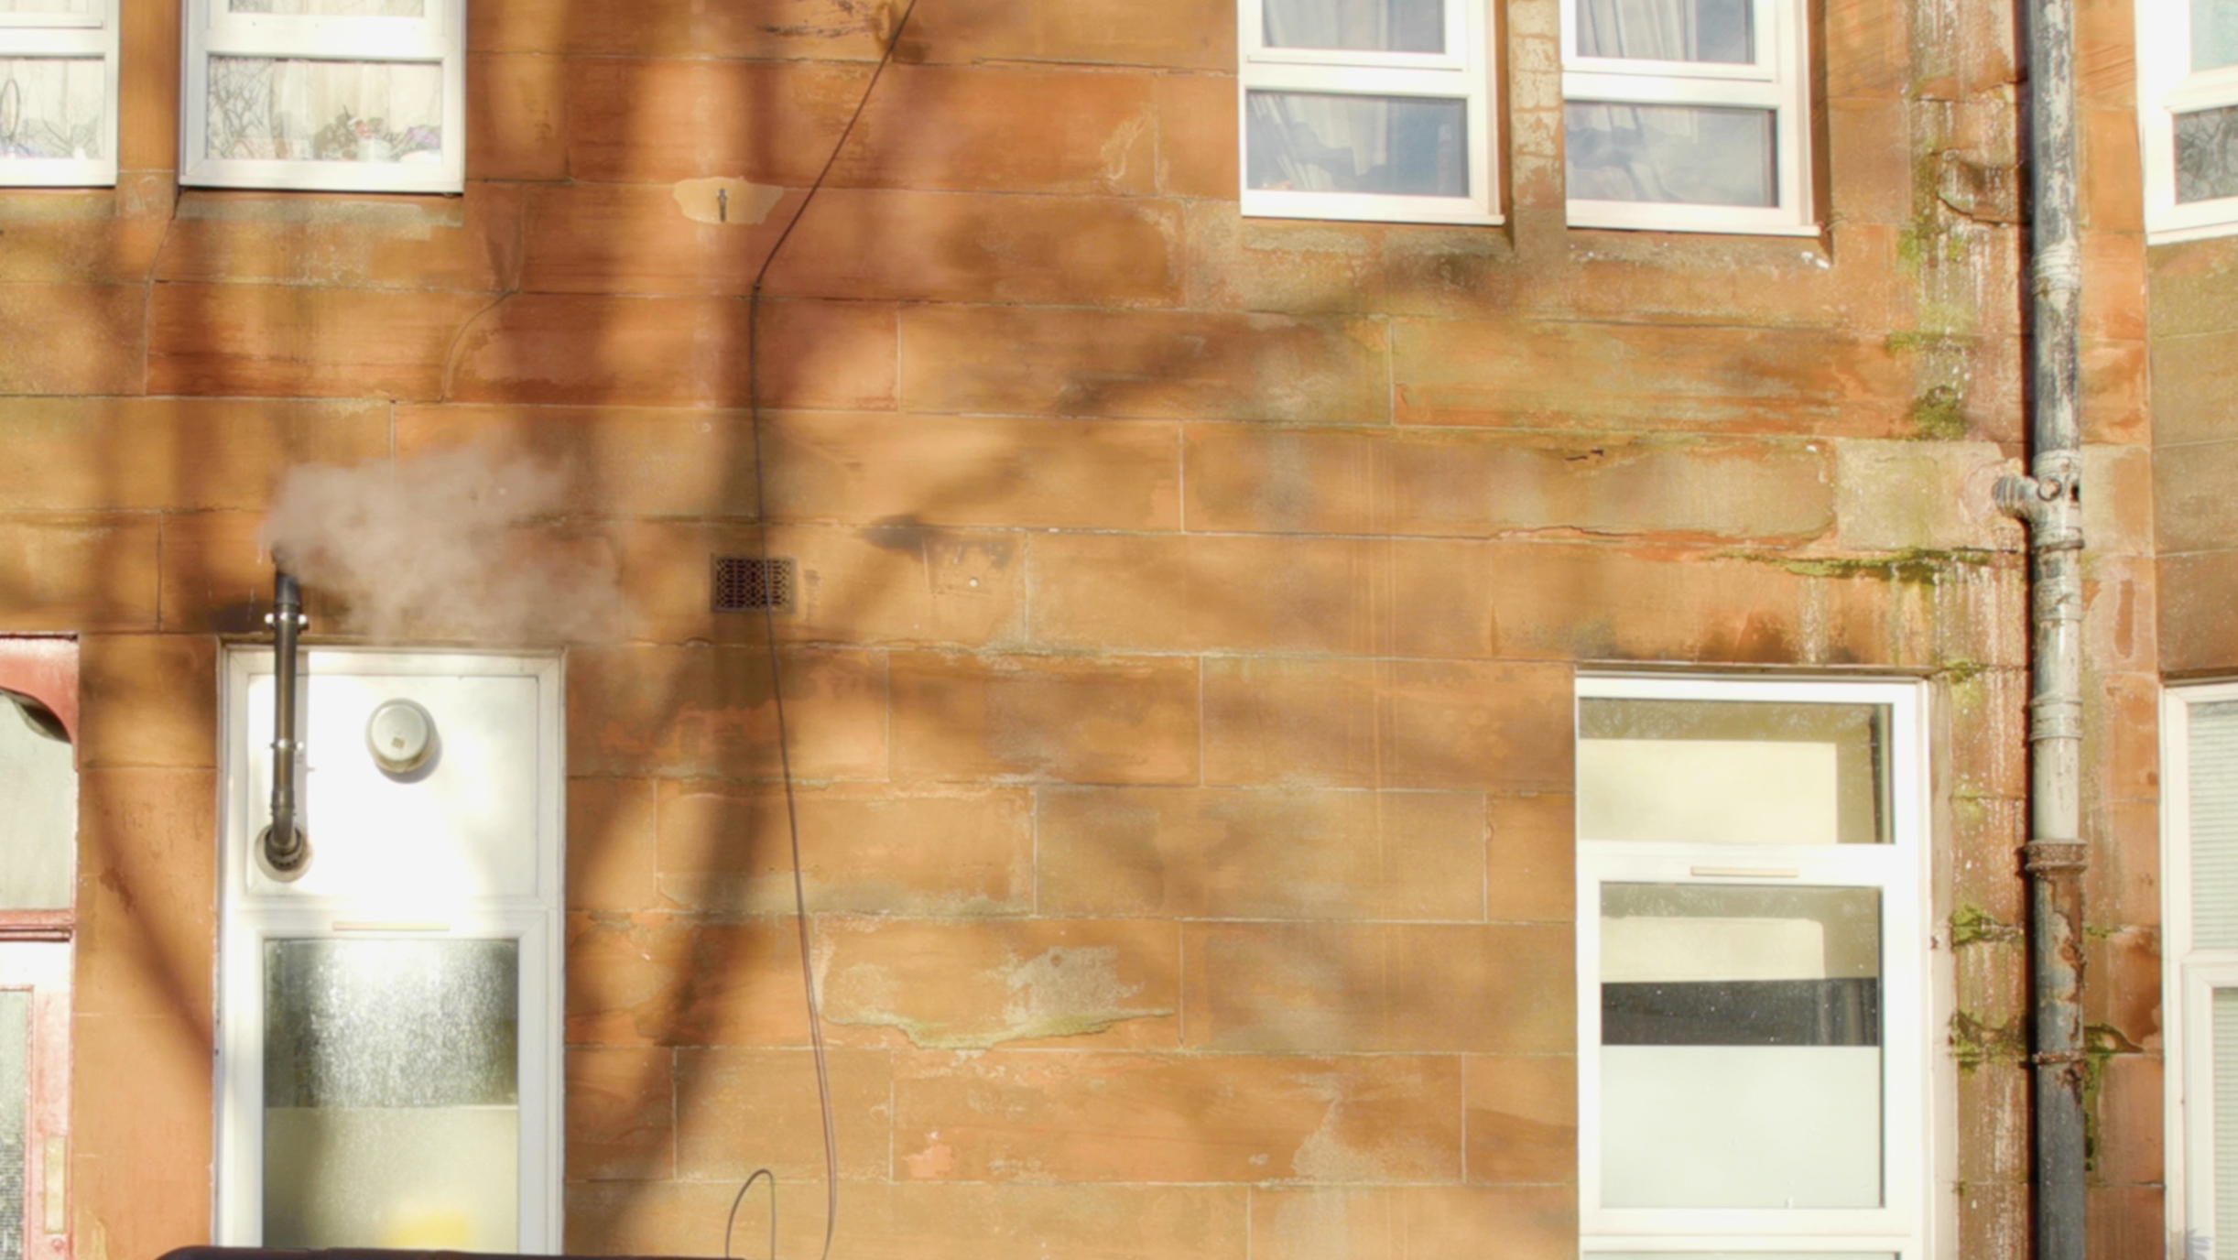
WATCH THE VIDEO

Slide 57
Scottish Empty Homes Conference 2024 Susan Aktemel; Founder and CEO Barry Sweeney; Head of Acquisitions and Assets

Slide 58
Community-led housing Southeast Scotland

Slide 59
SOSCH – who we are
SOSCH is Southern Scotland’s community-led housing enabler. SOSCH is recognised as the regional delivery partner for CLH in ScotGov’s Rural and Islands Housing Action Plan, 2023.
SOSCH was founded to address a shortfall in rural housing supply in Southwest Scotland. In 2020, SOSCH expanded its geography to cover whole of Southern Scotland.
SOSCH have a track record of delivery and have a pipeline of CLH projects with communities across the region.

Slide 60
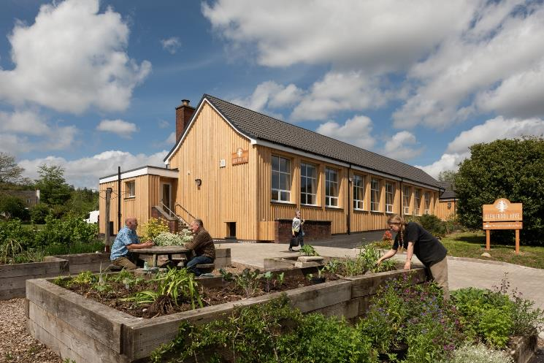
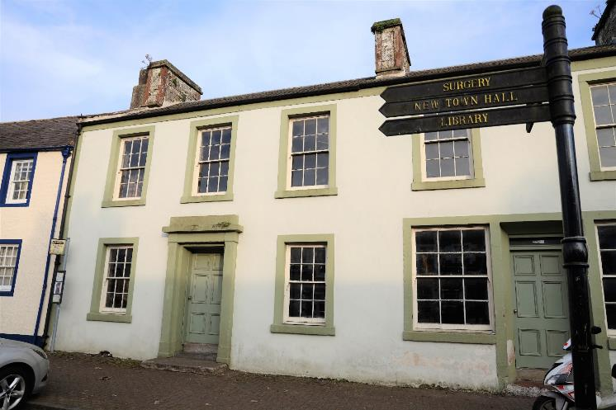
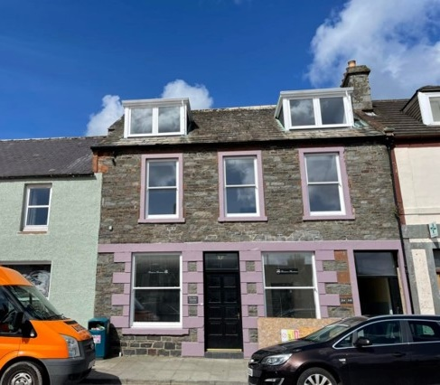
Langholm
Old Police Station
Glentrool
Hive & Housing Regeneration
Whithorn
Grapes Hotel Housing
Wigtown
Former Bank Housing and Bunkhouse

Slide 61
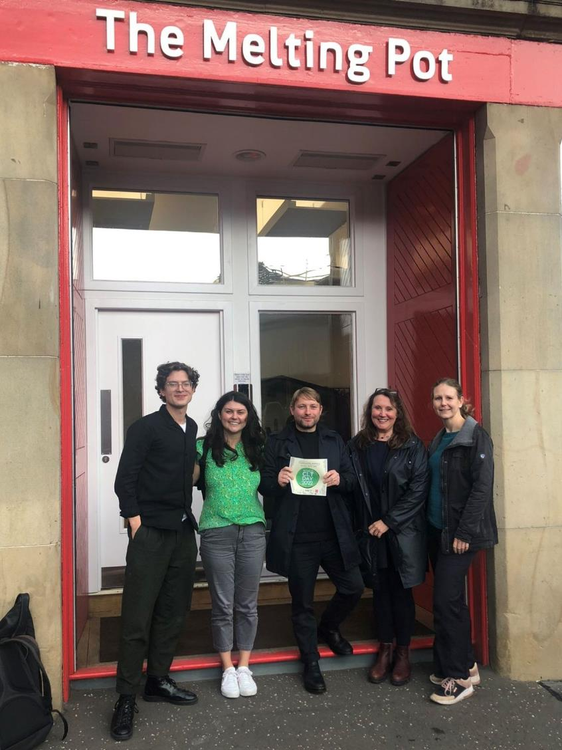
SOSCH – where we started
In 2022 SE Scotland Coordinator joined the team to support SOSCH’s activity in new geographies. The project’s main objectives were to:
Build local strategic partnerships
Raise awareness of community-led housing and empty homes
Support community-led housing projects (focus on empty homes)
SOSCH team, November 2022.

Slide 62
Building partnerships
The CLH Coordinator Project for SE Scotland is a partnership project between SOSCH and the SEHP. This core partnership has kick-started the project and helped to develop further partnerships in the region.
We have made a concerted effort to build partnerships within the Scottish Borders to help establish a presence and meet communities.
Scottish Borders Council: Housing & Communities teams
Borders Community Action (TSI)
Housing Associations
Community ownership support networks

Slide 63
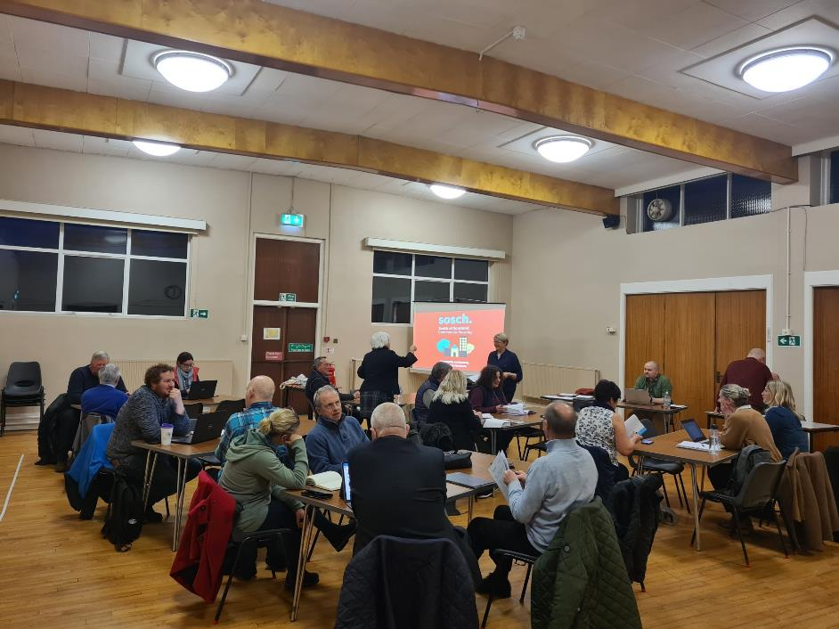
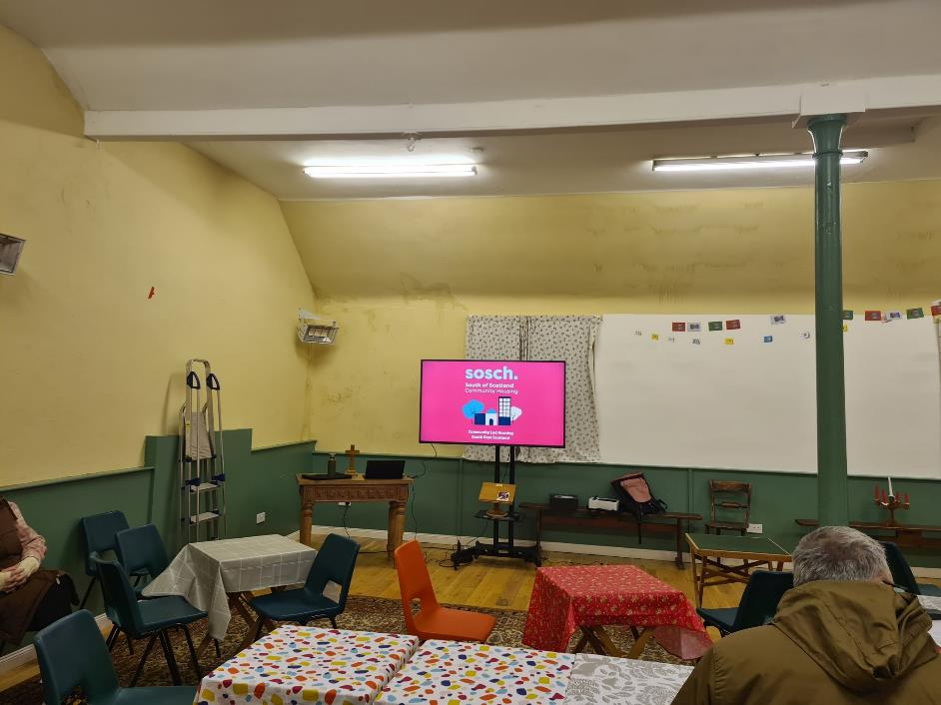
Teviot & Liddesdale Area Partnership Meeting.
Greenlaw & Hume Community Council Meeting.

Slide 64
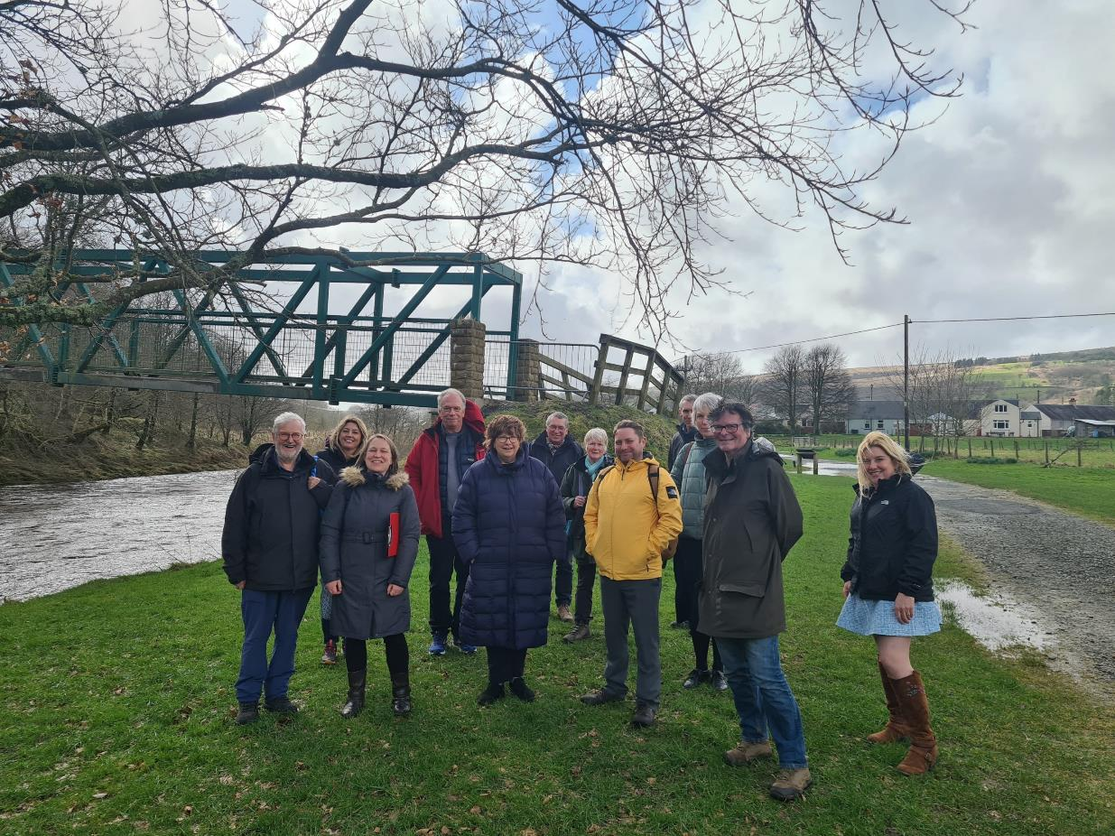
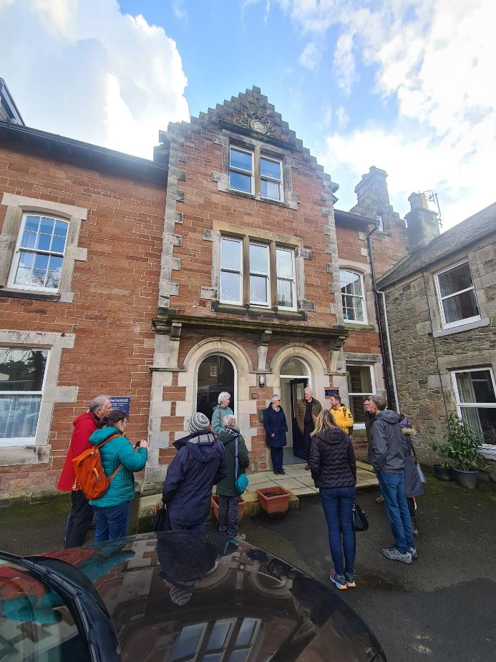
BAVS & SOSCH peer learning trip to Newcastleton & Langholm.

Slide 65
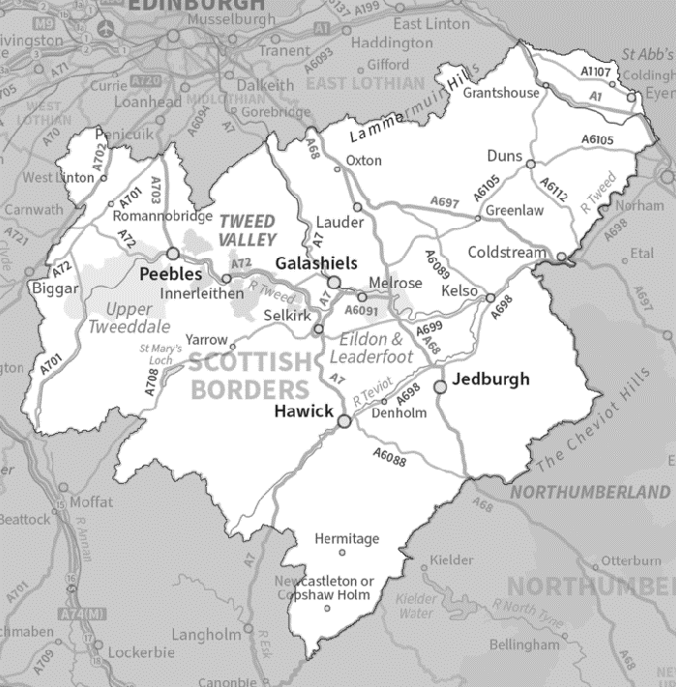
Meeting Communities
SOSCH have now received enquiries from approximately 30 communities in Southeast Scotland, some of which are highlighted here.
In addition to the Borders, SOSCH has also received enquiries from communities in Edinburgh, South Lanarkshire, and East Lothian.

Slide 66
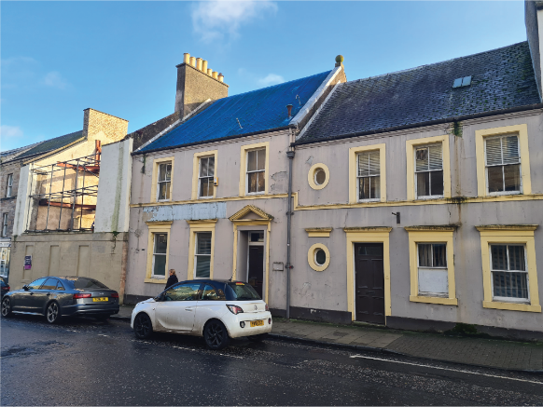
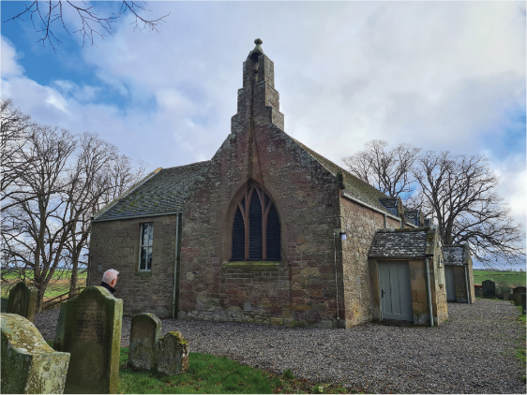
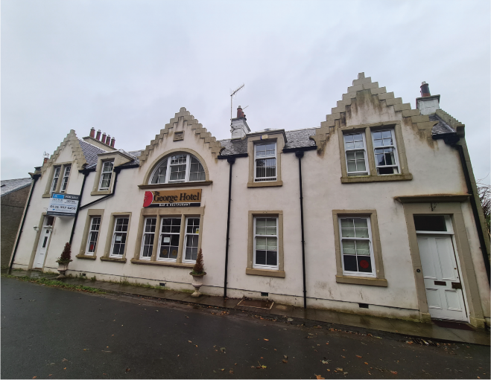

Slide 67
What we’ve done and what we’re doing now
SOSCH has laid the groundwork in year 1 which has led to the development of a pipeline of projects in Southeast Scotland.
As of year 2, SOSCH have begun working formally with communities in Southeast Scotland to develop community-led housing projects.
We have recently completed a Housing Need and Demand Assessment (HNDA) report for one community, enabling that community to progress towards feasibility work.
SOSCH have three more HNDAs underway for three communities. Two of them in the Borders, and one in South Lanarkshire.

Slide 68
What have been the lessons?
Communities need time and support to develop.
Limited existing community-led housing. One community-led housing project has been completed in the Borders.
Most of our emerging projects are with established community development trusts.
Barriers to early-stage work are significant – early-stage work (such as a HNDA) required to access dedicated feasibility funding is time intensive, and under-resourced communities can struggle to find the money.

Slide 69
What are the wider benefits?
Community-led housing can:
Build resilient communities who have the capacity to tackle a wide range of local issues.
Breathe new life into some of the most challenging derelict buildings in a community.
Support other related policy agendas, such as Land Reform and Community Wealth Building.

Slide 70
Community-led housing Southeast Scotland

Slide 72
Community Benefit Society
Offer social landlords and community groups a project management consultancy to enable housing development in the Outer Hebrides
We develop low-cost homes ownership “Rent to Buy” model
Other housing services include letting agent, energy advice and care and repair.
TIG Mission Statement “We will support and empower people to rent, buy and live in comfortable, affordable homes; promote independent and sustainable living solutions, and work to address fuel poverty and energy efficiency across our communities.”

Slide 73
Warts and All Assessment of the TIG Empty Homes Project

Slide 74
Aims and objectives of the project
Position as we near the end of the project
Lessons learned

Slide 75
Aims and objectives of the project
Sustain rural communities by finding a mechanism to bring back into use empty homes
Carry out 20 feasibility studies on empty homes
Take forward 12 to purchase and refurbishment
We had identified 3 different routes to fund the purchase and refurbishments

Slide 76
Current Position
21 properties not surveyed because they were not suitable.
8 surveys were cancelled mid way through
7 properties are being taken forward and are at various stages.
3 of them are in the first tranche of TIG properties
2 properties are going to be taken forward through a 4th route.

Slide 77
Fair amount of abortive work
Managing project costs is an issue
High projects costs meant that route 2 was the favored funding option.
Interest rates have soared since the project began causing an issue for the business plan

Slide 78
Concentration of properties in the Broadbay area around Stornoway.
Properties could be batched into groups for tendering in the east and west side of Lewis, Harris and then North and South Uist.
Streamlined feasibility process which reduces abortive work
29 Cancelled
5 Taking Forward
7 Under consideration/feasibility stage

Slide 79
Case Study: Grosclete House, Bays of Harris
Market value of the property in its current condition was £90,000.
Refurbishment cost estimate was £235,000.
Full refurbishment including internal insulation, new kitchen and sanitary wear, replacement of slates, external works and access road.
TIG could only offer £50,000
Final valuation once works complete £250,000.
Property on the market and has been for over 12 months.

Slide 80
Case Study: 47 Crossbost, Lochs, Isle of Lewis
Market value of the property in its current condition was £80,000.
Refurbishment cost estimate was £230,000.
Full refurbishment including internal insulation, new kitchen and sanitary wear, replacement of slates, new solid floor, new extension and new electrics.
TIG could only offer £50,000
Final valuation once works complete £175,000
Property on the open market.

Slide 81
Case Study: Partnership with The Paric Trust
4th Route to delivery – to work in partnership with the Community
TIG had worked with them before on a similar project
Pairc Trust wanted to be the Landlord
TIG to be development agent
Property to be rented out using TIG letting agent service.

Slide 82
Summary
Manage expectations of property owners
Work with all possible partners to reduce cost – property owners, contractors, community groups, HIE and the banks
Be flexible to local politics and priorities

Slide 83
Donna Smith Chief Executive Officer donna.smith@tighean.co.uk

Slide 84
Thanks to:
Scottish Empty Homes Partnership
CNES Empty Homes Officer

Slide 85
Health & Social Care Partnership Empty Homes Project Douglas Whyte Isla Binnie

Slide 86
Argyll & Bute Housing Emergency Summit 2023
What’s the evidence of housing shortage in Argyll & Bute?
The Housing Emergency in Argyll & Bute is driven by a complex range of issues with the scale of housing shortage and housing system pressure evident in the following statistics:
3,290
people on housing waiting lists in 2023 (up 8% on 2022). Argyll & Bute has 5% less social housing than average
28%
Increase in the number of households presenting as homeless in Argyll & Bute, in total 511 households
£206k
average housing price in 2022. This is 7 times average income levels in Argyll & Bute
11%
of all homes in Argyll & Bute are either second homes (6%) or empty (4%)
43%
of property sales are made to households living out with Argyll and Bute
131
private housing completions outside Helensburgh in the last 5 years on sites of 5+ units
17% of the expected rate (780)
22%
increase in 2022 construction costs 2022 (BICS) with island costs significantly higher
75%
of employers who responded to the workforce housing survey said a shortage of housing was a barrier to recruiting or retaining staff

Slide 87
Market Homes: Key Issues
In 2022/23, the average house price in Argyll & Bute (£219k) exceeded the Scottish average (£216k).
House prices have increased by 26% in the last 4 years
Just 1 in 4 households in Argyll & Bute can afford the average house price
Rural house prices are 24% higher than urban areas with just 1% sales in rural areas
In 2021/22, Argyll & Bute recorded the second lowest level of new housing completions of any local authority in Scotland at 31 completions per 10,000 households
Argyll & Bute is the most expensive place to build in mainland Scotland (AHIP grant rate adjustment)
Skills shortages and building site constraints are barriers to market housing development

Slide 88
Affordable Homes: Key Issues
There are c. 8,800 units of social housing, 18% of all stock which 5% lower than Scotland
Social rented stock has increased by just 3% (262 units) over last 5 years
Total vacancies in social housing have reduced by 20% since before the pandemic
There is 6 applicants for every available social let in Argyll & Bute (10:1 in Coll & Tiree)
In 2022/23, homeless applications were up by 28% on 2021/22, at 511 applications
Whilst the SHIP programmes the delivery of 1,000 affordable housing units between 2023-28, there has been 3 consecutive years of underspend in the programme
Home Argyll identifies significant demand for intermediate housing with limited delivery in the SHIP

Slide 89
Workforce Homes: Key Issues
The working age population in Argyll & Bute is projected to decrease by almost 30% by 2028
2/3 households believe young people are leaving their communities due to a lack of housing
77% of employers report that a shortage of housing is a contributing factor in recruitment and retention issues, with over 400 posts affected across 67 employers (6 posts per business)
90% of employers expect there to be a problem recruiting or retaining staff in the future
52% of employers have considered providing housing but discounted this because of financial constraints, a lack of homes to purchase, too much competition in the housing market
Public sector employers report recruitment pressures impacting on the delivery of essential services

Slide 90
Existing Homes: Key Issues
Over 15% of Argyll & Bute’s existing stock is not being utilised as a main residence including empty homes (4.4%), second homes (5.9%) and Short Term Lets (4.9%)
A&B records the highest level of second home ownership in Scotland
50% of households in Argyll & Bute cannot afford to access the housing market, with 43% sales to households from out with the area
For the first time in two decades, the private rented sector in Argyll & Bute is shrinking
There is a mismatch between households and homes in the social housing sector with 56% requiring a 1-bedroom property (2,284) and just 268 1-bedroom homes available

Slide 91
HSCP Empty Homes Officer
Encouraging LTE owners
Approaching current Landlords
Domestic & Commercial Properties
Funding
Leasing to Health & Social Care workers
Housing Options

Slide 92
Utilising Buildings
Mothballed NHS buildings
High demanding areas
Short term accommodation
2 bed shared proposal

Slide 93
2 bedroom shared accommodation

Slide 94
Island Projects
Doctor & Nurses Houses on Island of Coll
Strategic funding in progress to assist

Slide 95
Joint Working
Housing Associations
Strategic Funding
Shared accommodation

Slide 96
Need & Demand
Island Communities
Towns
Staff requirements

Slide 97
Lessons Learned & Beyond
Working in partnership
Patience
Supporting Staff
Promotion

Slide 98
Questions?
Douglas Whyte – douglas.whyte@argyll-bute.gov.uk
Isla Binnie – isla.binnie@argyll-bute.gov.uk

Slide 99
Lunch / sponsor exhibition

Slide 100
Visions for the Future: Empty Homes Work Across Scotland Lisa Borthwick and Andy Moseley, SEHP Catrin Evans, Cii Gillian Edwards, West Lothian Council

Slide 101
Visions for the Future – empty homes work across Scotland

Slide 102
Empty homes and the Scottish Empty Homes Partnership
The SEHP was formed following the Scottish Government’s review of the private rented sector in 2009 which identified that empty homes can play an important part in meeting our housing challenges.
“The Scottish Government should consider establishing a national empty homes resource…to provide support to local authorities and partnership groups and to liaise, where appropriate, with landlord and landowner organisations and other key organisations with interests in the Private Housing Sector.”

Slide 103
2010-2023: learning from the past…
The key focus for year 1 was establishing the Scottish Empty Homes Network to support empty homes work across Scotland and over time, the partnership’s objectives evolved as follows:
Encourage every council in Scotland to have a dedicated Empty Homes Officer
Encourage councils to mainstream empty homes work.
Encourage registered social landlords, community groups and other private bodies to engage in empty homes work.
Support the national network of Empty Homes Officers.
Deliver the Scottish Empty Homes Advice Service.
Notes:
Our goals in Phase 1 very much focussed on getting every council to employ a dedicated EHO. This has been successful with most councils now offering empty home owners advice and assistance.
However, with large volumes of homes lying empty, one EHO is often not enough and we have more and more councils looking at whether they should and can increase their empty homes resource and how they can take a more tactical approach for maximum impact.

Slide 104
…to visions for the future:
the start of ‘phase 2’ for the partnership and empty homes work across Scotland today
Support the Scottish Government in the implementation of its Housing to 2040 strategy and commitment to empty homes aspects of a National Acquisition Plan.
Encourage every LA to adopt a strategic approach to bringing empty homes back into use.
Promote evidence-based benefits of bringing empty homes back into use to encourage diverse involvement in empty homes work across Scotland.
Support the network of dedicated empty homes officers through the provision of training and best practice sharing.
Run the Scottish Empty Homes Advice Service.
Notes:
This ties in with the housing context today. Empty homes work is certainly not solely about increasing housing supply – there’s so many wide reaching benefits of bringing empty homes back into use. However, whilst our aim in the first 13 years of the partnership was to bring as many privately-owned empty homes back into use as possible, our new objectives reflect the need for a more targeted approach to empty homes work.
Our new aim focuses on supporting the Scottish Government’s commitment to bringing empty homes back into use as affordable housing where possible – reflecting the huge housing demand across the country illustrated in part by the three local authorities who have declared housing emergencies to date, as well as everything else mentioned in the panel discussion this morning. Our objectives also reflect the unique budgetary challenges facing Scottish local authorities today – and why we’re looking at how we can support and encourage local authorities to adopt a strategic approach to bringing empty homes back into use to maximise the impact of empty homes work within the council.
[segue to Andy]

Slide 105
Visions for the Future – empty homes work across Scotland The Strategic Empty Homes Framework

Slide 106
The Strategic Empty Homes Framework Guidance and Template
Scottish Empty Homes Partnership had identified the need for a framework that local authorities can use to help to mainstream empty homes work and link it more fully with delivery of all parts of their Local Housing Strategy.
In 2022 SEHP commissioned Arneil Johnston to work with us to develop advisory guidance for local authorities on producing a Strategic Empty Homes Framework.

Slide 107
Developing the Framework
The guidance was developed over a twelve month period, beginning with two workshops exploring links with local housing strategies, developing an evidence base and setting objectives.
A draft of the Framework was launched at our Annual Conference in March.
A further workshop was held with some of our most experienced EHOs to walk through the template and ensure that it worked for them.
The final guidance and template were published on September 15.

Slide 108
The Eight Step Programme

Slide 109
It’s not just local authorities that need the affordable housing target to be met.
We have;
Rising house prices, rents and build costs
People unable to afford to buy or rent in the places they grew up or work in.
Increasing numbers of people on housing waiting lists
Local authorities declaring housing emergencies
In 2022-23:
There were 39,006 applications for homelessness.
There were 32,242 households assessed as homeless or threatened with homelessness.
There were 15,039 households in temporary accommodation at 31 March 2023 – a 6% increase compared with 14,214 at 31 March 2022.
At the same time we have;
46,217 long term empty homes.
28,280 homes that have been empty for more than a year
47,293 unoccupied exemptions – including homes empty due to the death of a previous owner, the owner being in long term care or the property being repossessed.
Notes:
An annual update on Homelessness Statistics covering 2022-23 released by Scotland’s Chief Statistician shows that:

Slide 110
EHOs and SEHP have achieved so much
Over 9,000 long term empty homes brought back to use since 2010
It took 3 years to reach 100
It took almost 6 years to reach 1,000
In the last 5 years 5,800 homes have come back to use
We have set up 4 kickstarter projects with third sector organisations to bring homes back to use as social and affordable housing since 2021.
A 5th project is announced today.
The Empty Homes Audit recognised the tremendous achievements of us all
‘The most effective means of bringing properties back into use is through an EHO being employed to prioritise empty homes action.’
‘The number of EHOs has increased considerably since the inception of SEHP and it is clear that this would not have been achieved without its support and influencing role.’

Slide 111
But, unless we think strategically, we can only go so far
There is only so much that can be achieved by an Empty Homes Officer working in isolation, and dealing with homes on a reactive, case by case basis.
Empty homes work needs to be targeted at areas where it can have the greatest impact.
There needs to be an evidence based approach that looks at supply and demand and tries to match the two.
There needs to be buy in across the local authority based on an understanding of the link between resources and delivery and the contribution empty homes work can make.
Tackling empty homes has to be part of place based development plans and other initiatives, not a stand alone activity.
There needs to be mechanism for setting and monitoring outcomes from empty homes work, showing what it can deliver and how it will deliver.

Slide 112
Empty Homes are the asset on our doorstep
We can do so much if we think strategically about empty homes.
We can create more homes for less money in less time.
We can help to revive our town centres.
We can work towards realising twenty minute neighbourhoods and support place-based planning.
We can provide housing, training and hope for some of the most vulnerable groups in society
We can sustain some of our most fragile communities.
We can reduce population drift.
We can help restore a sense of pride and a sense of place.
We can reduce our reliance on cars.
We can preserve more of our green spaces.
We can reduce our embodied carbon emissions.

Slide 113
It makes environmental sense
A building that can be net zero to maintain is anything but net zero to build;
Operational and Embodied Carbon Emissions
Operational - The emissions created by running and heating a house.
Embodied - The emissions associated with creating the house.
Circular Ecology note that;
‘Embodied carbon emissions make up a large fraction of the emissions from the construction sector. In fact, it is often 20-50% of the whole life (embodied + operational) carbon emissions of a new building.
Green Finance Institute – ‘Financing energy efficient buildings: the path to retrofit at scale’ found that;
‘Energy efficiency measures and other building retrofit works are among the most cost-efficient ways to reduce emissions, with many co-benefits including improved living standards, healthier and more resilient communities, and the delivery of new, skilled green jobs in every part of the country.

Slide 114
It makes economic sense
Empty homes are problems that can also be part of solutions, by making use of what’s already there.
Only need to acquire property – established locations, planning permission in exceptional cases only
Short lead times between acquiring property and commencing work
Average time from purchase to completion – 6 months where structural renovation/alteration required.
Average cost – estimated that you can bring 3 empty homes back to use for the cost of 1 new house.
Quicker delivery of home to person in need of home. Earlier generation of rental income.

Slide 115
How the partnership can support you
The Empty Homes Framework Guidance and Template are available on our website at https://emptyhomespartnership.scot/empty-homes-framework/
The template can be downloaded and used as the basis for your own version. We can also provide word versions.
The partnership can advise on how to complete the template, we can suggest what to include, what to leave out, and how to make sure the template works for your audience.
We can help you with obtaining and analysing data on empty homes in your local authority.
We can suggest local, national and international case studies that can back up initiatives that you’d like to pursue, or trigger off ideas for things that might work.

Slide 116
Visions for the Future – empty homes work across Scotland The Strategic Empty Homes Framework

Slide 117
Scottish Empty Homes Partnership
West Lothian Council and Shelter Scotland Kickstarter Project
29th February 2024

Slide 118
Kickstarter Project
Introduction
Kickstarter project – Collaborative Approach
Context for Empty Homes Work in West Lothian
Making best use of existing housing stock to address homelessness
Role of Empty Homes Officer
Our future approach

Slide 119
Introduction
West Lothian Council was one of the early members of the Empty Homes Partnership back in 2012
In the past we have employed a number of empty homes officers but because of budget issues we didn’t retain a dedicated EHO but included it with other work
Scottish Empty Homes Partnership (SEHP) approached WLC around 2 years ago to consider whether we would consider co funding an Empty Homes Post
SEHP have provided excellent support on and ongoing basis with individual cases
Lack of housing supply in West Lothian and high levels of homelessness means a renewed focus on empty homes work

Slide 120
Kickstarter Project - A collaborative approach
Discussions commenced in 2023 with SEHP to consider the appointment of a dedicated Empty Homes Officer
SEHP agreed at an early stage to support a post in West Lothian
WLC interested in expanding the approach to empty homes and align with making best use of existing housing
Recruitment commenced in November 2023
Good interest in the post and appointment of successful candidate
January 2024 (Grace Lummi)

Slide 121
Context - Empty Homes in West Lothian
There are around 250 long term empty homes in West Lothian
There are around 80 second homes
Not a huge scale but many cases are complex – owners not able to be traced
Some of the properties are in poor condition
Enquiries generated through contact from councillors and the public

Slide 122
Making best use of housing stock to address homelessness
In West Lothian we have around 11,000 people on the common housing register and around 600 people in temporary accommodation
Making best use of housing is important and bringing homes back into use is a priority.
As a council we are working hard to minimise the number of empty council houses
We have also purchased in excess of 200 former council properties on the open market over the past 5 years, many of which were empty.
We want to encourage owners of empty homes to bring homes back into use to increase the supply of housing and help to tackle homelessness

Slide 123
Role of the Empty Homes Officer
Engagement across a range of council services to establish a network of contacts to address empty homes
Review the list of long term empty homes and consider priorities for engagement with home owners
Work closely with SEHP colleagues and EHOs in other councils to understand the best techniques for working with owners of empty homes
Respond to enquiries on empty homes
Update the council’s web page to provide advice and information on bringing empty homes back into use, with appropriate links to SEHP website and other sources of information
Develop an Empty Homes Strategy to link with the Local Housing Strategy

Slide 124
Our Future Approach
We will develop an Empty Homes Strategy that has clear links to the Local Housing Strategy and to addressing homelessness
We will develop a collaborative approach across the council to tackle empty homes
engaging with Council Tax, Environmental Health, Community Safety, Private Sector Housing
to develop a more collaborative approach to tackling empty homes. We will also engage
with the Police & SFRS as appropriate
We will work closely with home owners to encourage them to bring houses back into use, specifically for people in housing need. This will require close working with our Housing Needs team.
We will review and update the Empty Homes information on the council’s website
There will be close working with SEHP colleagues to learn the best techniques
to engage owners to bring homes back into use.
We will monitor the outcomes of work on empty homes as part of the overall approach to increasing housing supply in West Lothian

Slide 125
Scottish Empty Homes Partnership
West Lothian Council and Shelter Scotland Kickstarter Project
29th February 2024

Slide 126
SEHP/The Cii – Dundee Project
Catrin Evans – Head of Development

Slide 127
Launched first project in 2017
Since then – have brought 10 empty homes back into use
Supported over 300 people to improve their circumstances
2022-24
Have started two new community regeneration programs
From 60 beneficiaries to over 150 beneficiaries a year
From 6 staff to 12

Slide 128
Swansea
Dundee

Slide 129
Year 1
Year 2
Long-term
Engage with at least 150 local people
Consult with at least 50 local and national organisations
Publish 1 report detailing consultation, community engagement and learning from year one
Develop a project framework in consultation with stakeholders to facilitate peer learning
Secure major funding for multi-year empty homes regeneration project
Create and fill at least three new roles including two project tutors and an engagement and wellbeing officer
Develop at least 5 close partnerships with local organisations to facilitate project delivery
Create one full project plan and timeline
Identify and purchase one project property
Publish 1 report detailing project development and learning in year two
Aim to break ground on the first property in our Dundee program end of year 2
Program will be designed to last at least three years, bringing six empty properties back into use and supporting over 180 local people
Our aim is that the properties will be used to house vulnerable people once they are renovated.

Slide 130
Project Delivery
Dundee project coordinator role
Full-time role entirely dedicated to the development of Dundee project
Support and oversight from management team
Project coordinator and chief exec will form part of advisory board – will receive support from SEHP staff.

Slide 131
Thank you to The Scottish Empty Homes Partnership for supporting this project.

Slide 132
Introducing Cromore, a Western Isles empty home project Murdo Macleod, Comhairle nan Eilean Siar Karis Beattie, Renovator of Cromore

Slide 133
WATCH THE VIDEO

Slide 134
Introducing Cromore, a Western Isles empty home project Murdo Macleod, Comhairle nan Eilean Siar Karis Beattie, Renovator of Cromore

Slide 135
Afternoon tea break / sponsor exhibition

Slide 136
Awards presentation John Loudon Auction House Scotland

Slide 137
Award – Best use of empty homes to meet social/affordable housing need

Slide 138
Social/Affordable: The Y Centre

Slide 139
Social/Affordable: Ballatar

Slide 140
Social/Affordable: Glentrool & Bargrennan Community Trust

Slide 141
Social/Affordable: Ballatar

Slide 142
Award – Special recognition award

Slide 143
Special recognition: John Loudon

Slide 144
Special recognition: Dawn Meston

Slide 145
Special recognition: Barry Sweeney

Slide 146
Special recognition: Dawn Meston

Slide 147
Award – Best renovation by the public

Slide 148
Housing renovation public: Robert Tai

Slide 149
Housing renovation public: Lisa & Sean Harkins

Slide 150
Housing renovation public: Karis Beattie & David Skene

Slide 151
Housing renovation public: Robert Tai

Slide 152
Award – Best renovation by the housing sector

Slide 153
Housing renovation sector: Chalmers Street

Slide 154
Housing renovation sector: Bulldale Street, Yoker

Slide 155
Housing renovation sector: Havelock Street

Slide 156
Housing renovation sector: Chalmers Street

Slide 157
Award – Best environmentally friendly retrofit

Slide 158
Environmentally friendly retrofit: Barnes House

Slide 159
ENVIRONMENTALLY FRIENDLY RETROFIT: ST. KENTIGERN’S CHURCH

Slide 160
Environmentally friendly retrofit: Sapphire House, Jedburgh

Slide 161
Environmentally friendly retrofit: Barnes House

Slide 162
Ministerial Address and Q&A session Paul McLennan MSP

Slide 163
WATCH THE VIDEO

Slide 164
Chair’s closing remarks John Mills ALACHO and Fife Council

